Slide 1

Discrete Math Chapter 8
Computer Logic

Slide 2
Chapter 8 Overview
8-1 Boolean Algebra Structure
8-2 Logic Networks
8-3 Minimization

Slide 3
Notes of Chapter 8
In this chapter, we will learn how to design CPU circuits.
Chapter 8 is based on chapter 1; make sure you don’t skip chapter 1 before learning chapter 8.

Slide 4

8-1 Boolean Algebra Structure

Slide 5
Boolean Algebra
Boolean algebra is the branch of algebra in which the values of the variables are the truth values true and false, usually denoted 1 and 0, respectively. (Domain and codomain of Boolean Algebra is {0, 1}.)
Instead of elementary algebra, where the values of the variables are numbers and the prime operations are addition and multiplication, the main operations of Boolean algebra are conjunction, disjunction and negation.
For example, in Boolean Algebra, 1 + 1 is 1, since it means ”True or True”. The disjunction of 2 true values would be true as well; therefore, 1 + 1 = 1.

Slide 6
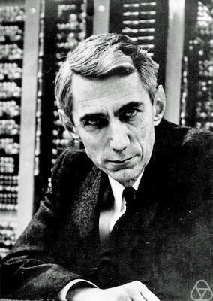
Boolean Algebra
Claude Elwood Shannon (1916 – 2001) was an American mathematician, electrical engineer, and cryptographer known as "the father of information theory". Shannon founded information theory with a landmark paper, "A Mathematical Theory of Communication", which he published in 1948.
He also founded digital circuit design theory in 1937, when—as a 21-year-old master's degree student at the Massachusetts Institute of Technology (MIT)—he wrote his thesis demonstrating that electrical applications of Boolean algebra could construct any logical numerical relationship. Shannon contributed to the field of cryptanalysis for national defense during World War II, including his fundamental work on codebreaking and secure telecommunications.

Slide 7
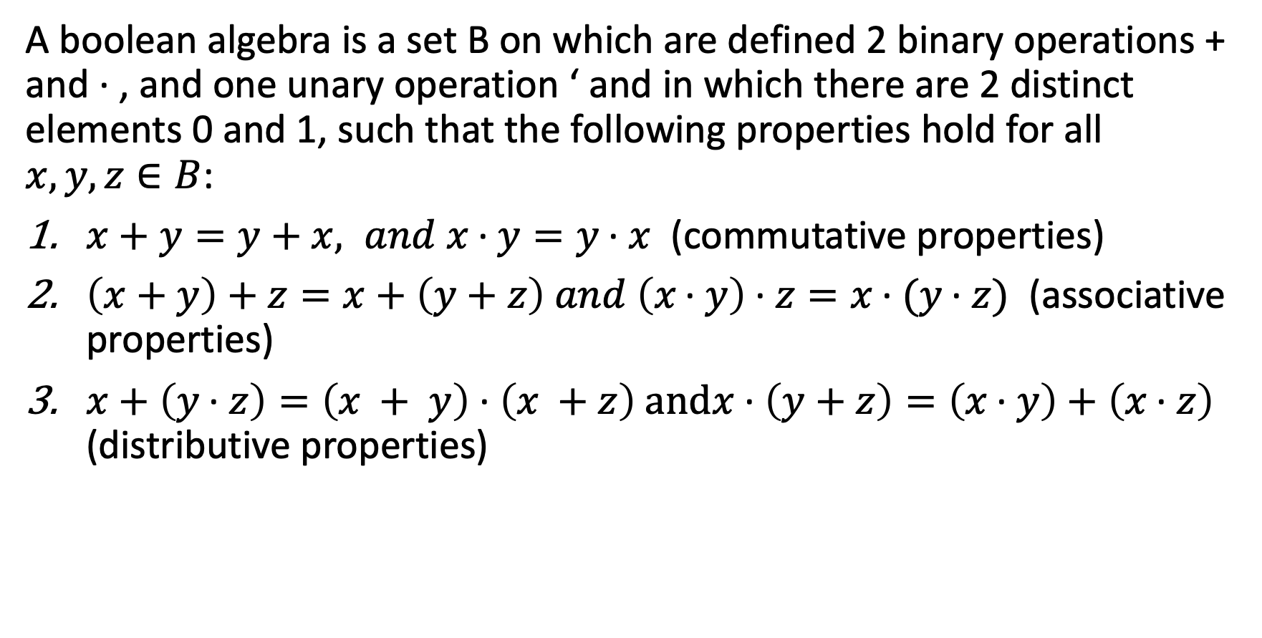
Definition of Boolean Algebra
A boolean algebra is a set B on which are defined 2 binary operations + and · , and one unary operation ‘ and in which there are 2 distinct elements 0 and 1, such that the following properties hold for all $x, y, z∈B$:
$x+y=y+x, and x \text{·} y=y \text{·} x$ (commutative properties)
$\left(x+y\right)+z=x+\left(y+z\right) and \left(x \text{·} y\right) \text{·} z=x \text{·} (y \text{·} z)$ (associative properties)
$x+\left(y \text{·} z\right)=\left(x + y\right) \text{·} \left(x +z\right) \text{and}x \text{·} \left(y+z\right)=\left(x \text{·} y\right) \text{+} \left(x \text{·} z\right)$ (distributive properties)

Slide 8
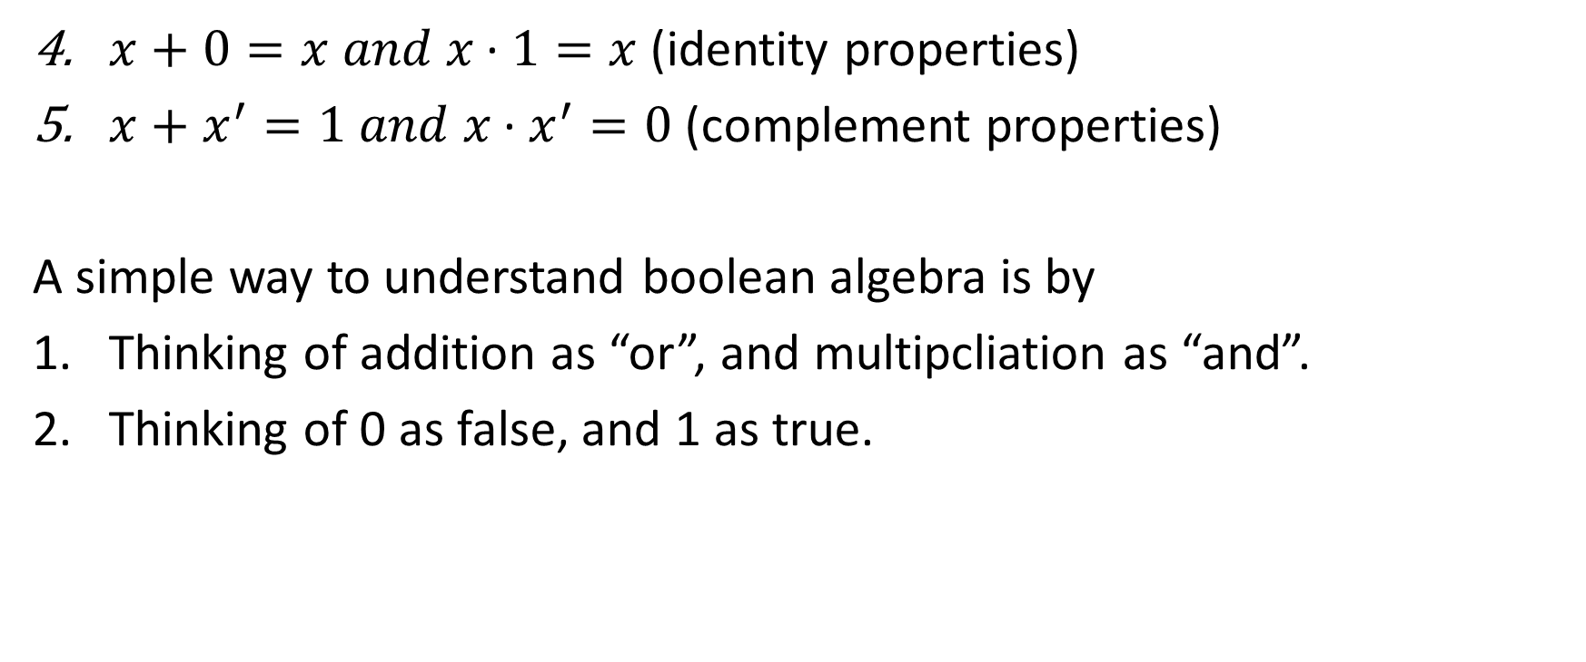
Definition of Boolean Algebra
$x+0=x and x \text{·} 1=x$ (identity properties)
$x+x^{′}=1 and x \text{·}{ x}^{′}=0$ (complement properties)
A simple way to understand boolean algebra is by
Thinking of addition as “or”, and multipcliation as “and”.
Thinking of 0 as false, and 1 as true.

Slide 9
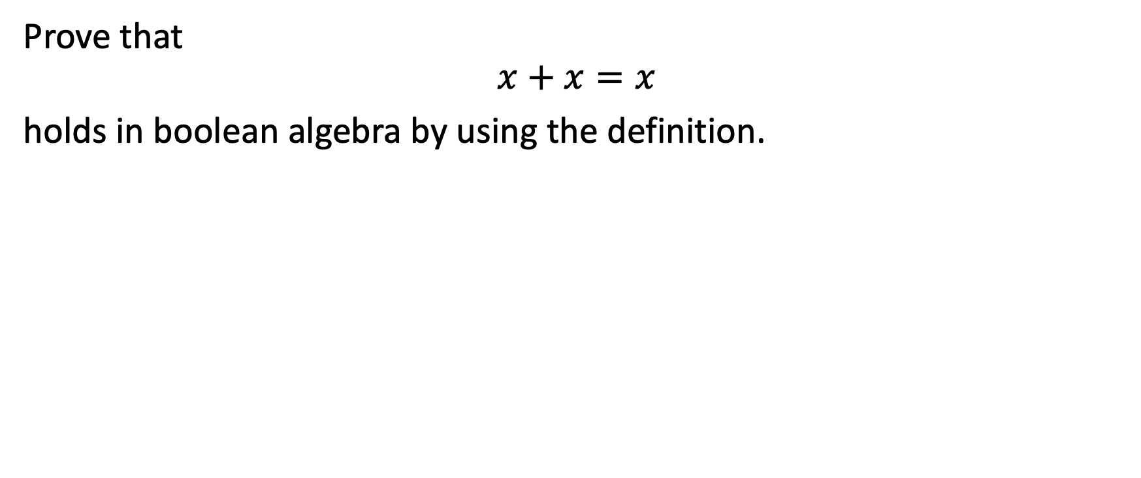
Example 8-1-1
Prove that
$$x+x=x$$
holds in boolean algebra by using the definition.

Slide 10
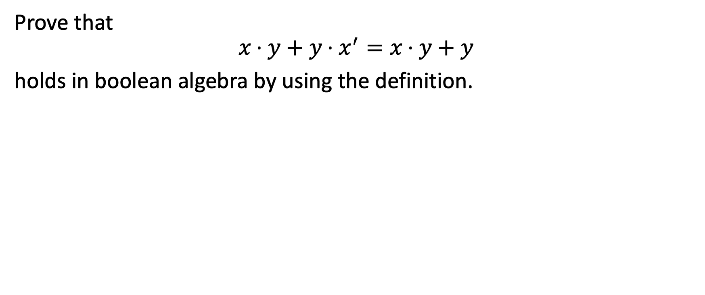
Example 8-1-2
Prove that
$$x \text{·} y+y \text{·} x^{′}=x \text{·} y+y$$
holds in boolean algebra by using the definition.

Slide 11
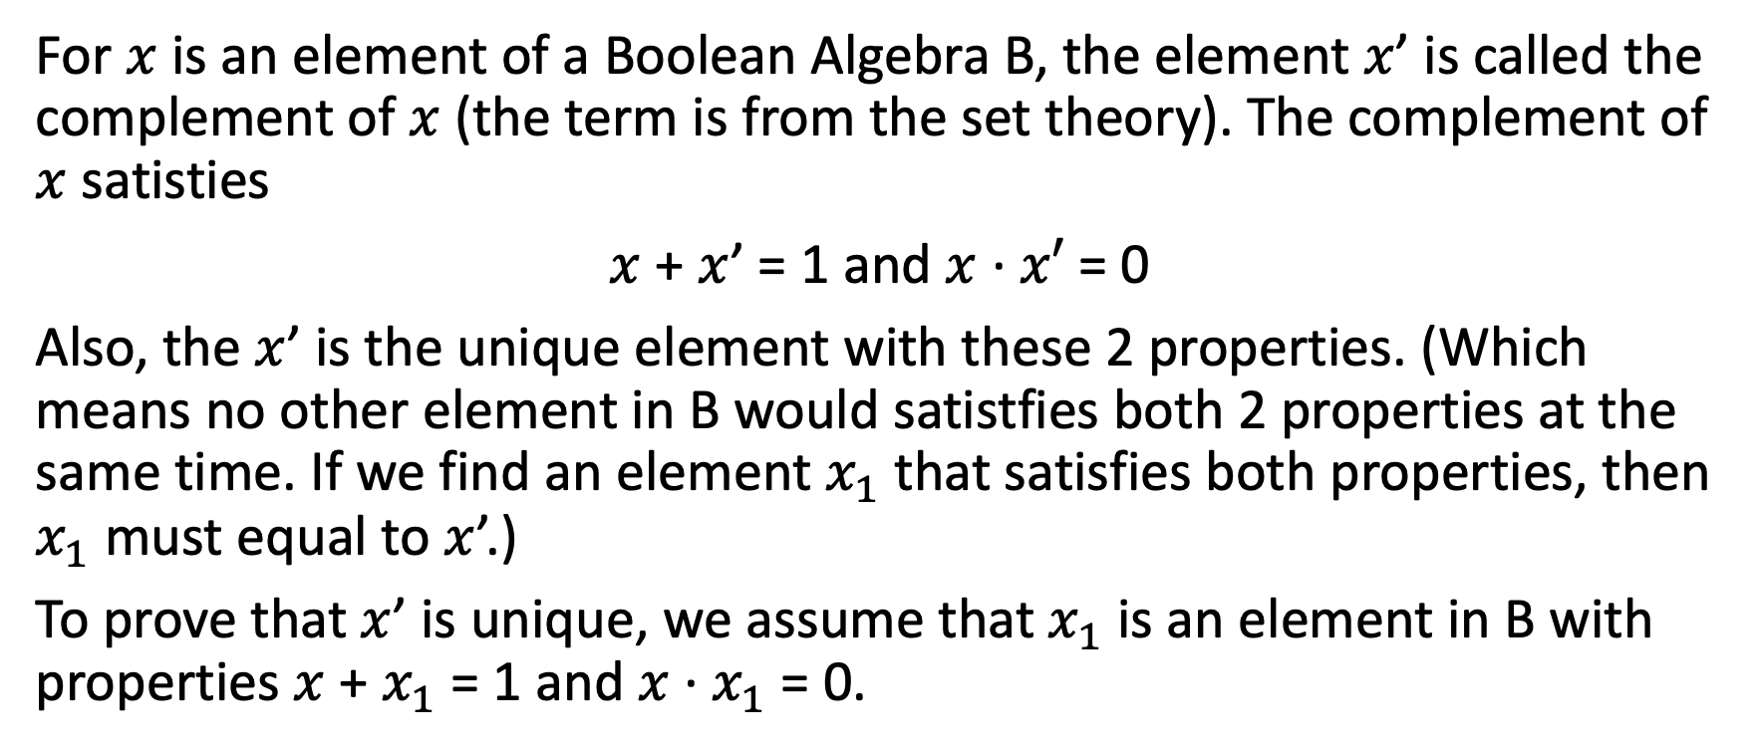
The Uniqueness of the Complement
For $x$ is an element of a Boolean Algebra B, the element $x$’ is called the complement of $x$ (the term is from the set theory). The complement of $x$ satisties
$x$ + $x$’ = 1 and $x$ $\text{·}$ $x′$ = 0
Also, the $x$’ is the unique element with these 2 properties. (Which means no other element in B would satistfies both 2 properties at the same time. If we find an element $x_{1}$ that satisfies both properties, then $x_{1}$ must equal to $x$’.)
To prove that $x$’ is unique, we assume that $x_{1}$ is an element in B with properties $x$ + $x_{1}$ = 1 and $x$ ${\text{·} x}_{1}$ = 0.

Slide 12
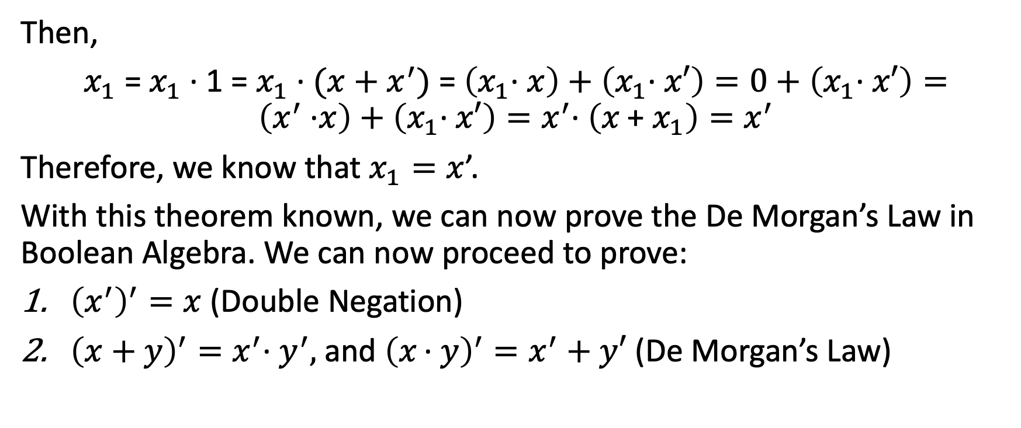
The Uniqueness of the Complement
Then,
$x_{1}$ = $x_{1} \text{·}$ 1 = $x_{1} \text{·}$ $(x+x^{′})$ = $\left(x_{1}\text{·} x\right)+$ $\left(x_{1}\text{·} x′\right)=0+$ $\left(x_{1}\text{·} x′\right)=\left(x^{′} \text{·}x\right)+\left(x_{1}\text{·} x′\right)=x^{′}\text{·} \left(x\text{ + }x_{1}\right)=x^{′}$
Therefore, we know that $x_{1}=x$’.
With this theorem known, we can now prove the De Morgan’s Law in Boolean Algebra. We can now proceed to prove:
${\left(x^{′}\right)}^{′}=x$ (Double Negation)
${\left(x+y\right)}^{′}=x^{′}\text{·} y^{′},$and ${\left(x \text{·} y\right)}^{′}=x^{′}+y′$ (De Morgan’s Law)

Slide 13
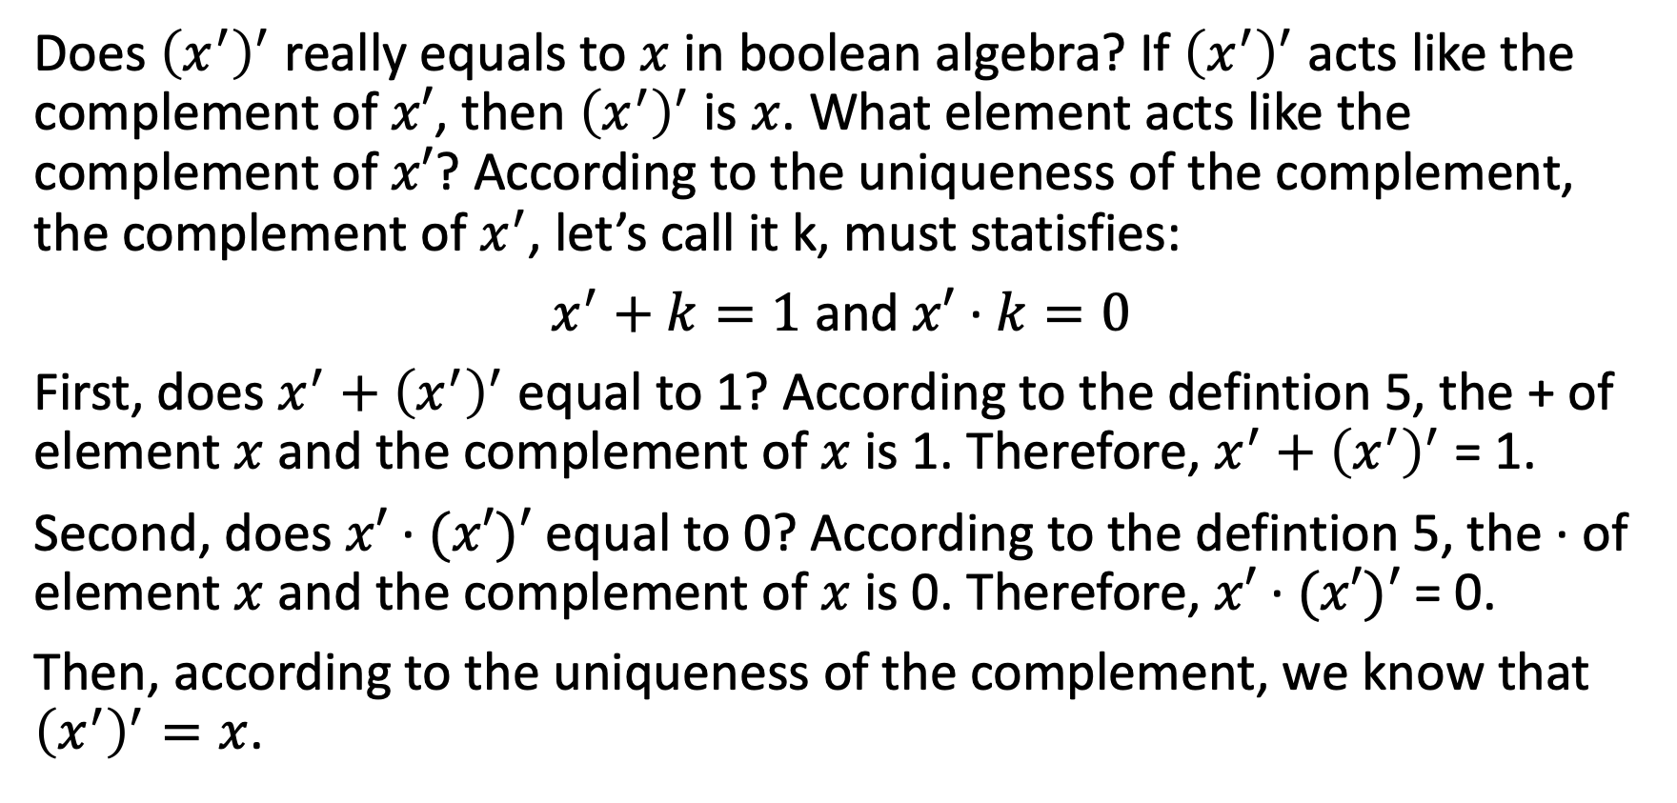
Proof I
Does ${\left(x^{′}\right)}^{′}$ really equals to $x$ in boolean algebra? If ${\left(x^{′}\right)}^{′}$ acts like the complement of $x′$, then ${\left(x^{′}\right)}^{′}$ is $x$. What element acts like the complement of $x′$? According to the uniqueness of the complement, the complement of $x^{′}$, let’s call it k, must statisfies:
$x^{′}+k=1$ and $x′$ $\text{·}$ $k=0$
First, does $x^{′}+{\left(x^{′}\right)}^{′}$ equal to 1? According to the defintion 5, the + of element $x$ and the complement of $x$ is 1. Therefore, $x^{′}+{\left(x^{′}\right)}^{′}$ = 1.
Second, does $x′$ $\text{·}$ $(x′)′$ equal to 0? According to the defintion 5, the $\text{·}$ of element $x$ and the complement of $x$ is 0. Therefore, $x′$ $\text{·}$ $(x′)′$ = 0.
Then, according to the uniqueness of the complement, we know that ${\left(x^{′}\right)}^{′}=x$.

Slide 14
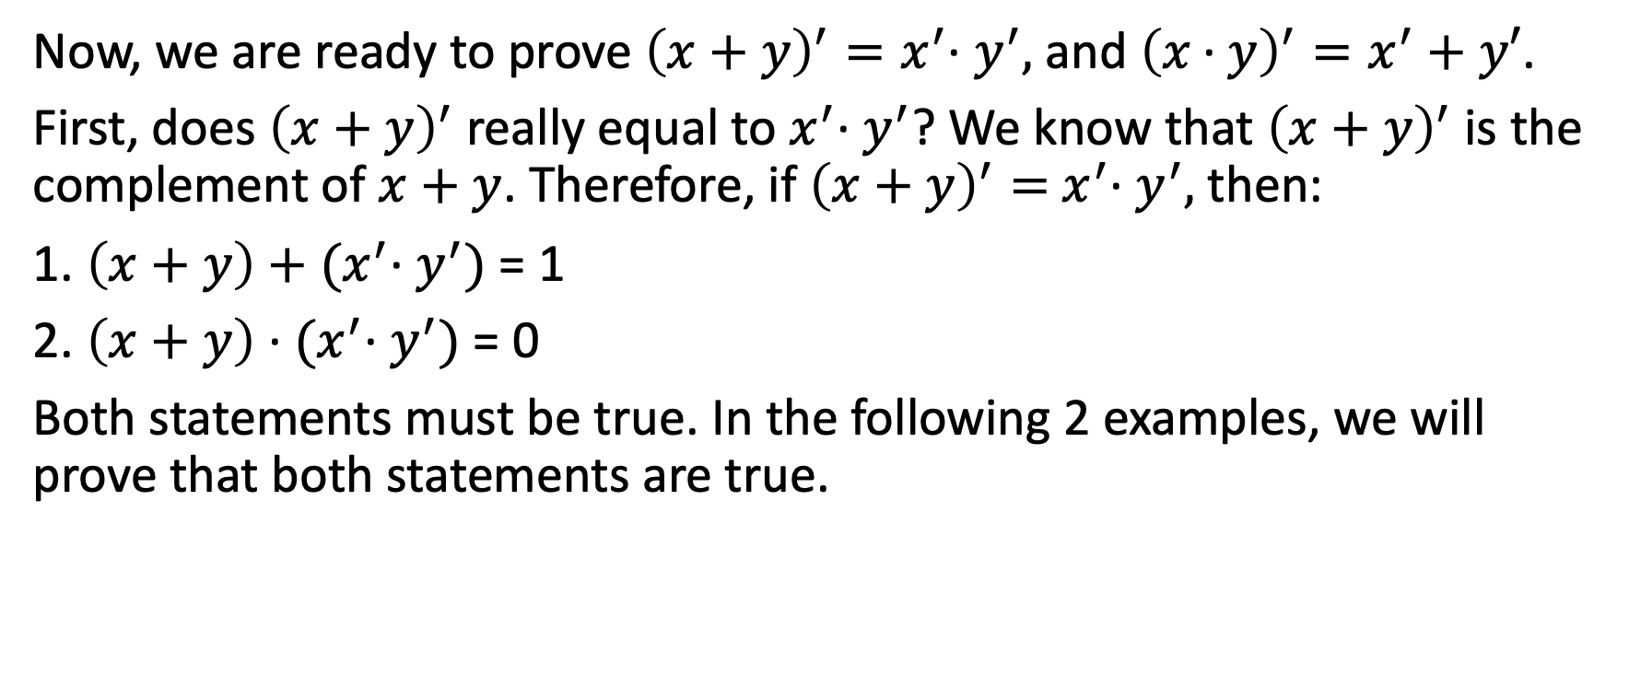
Proof I
Now, we are ready to prove ${\left(x+y\right)}^{′}=x^{′}\text{· }y^{′},$and ${\left(x \text{·} y\right)}^{′}=x^{′}+y′$.
First, does ${\left(x+y\right)}^{′}$ really equal to $x^{′}\text{· }y^{′}$? We know that ${\left(x+y\right)}^{′}$ is the complement of $x+y$. Therefore, if ${\left(x+y\right)}^{′}=$ $x^{′}\text{· }y^{′},$ then:
1. $\left(x+y\right)+$ ${(x}^{′}\text{· }y^{′})$ = 1
2. $\left(x+y\right)$ $\text{·}$ ${(x}^{′}\text{· }y^{′})$ = 0
Both statements must be true. In the following 2 examples, we will prove that both statements are true.

Slide 15
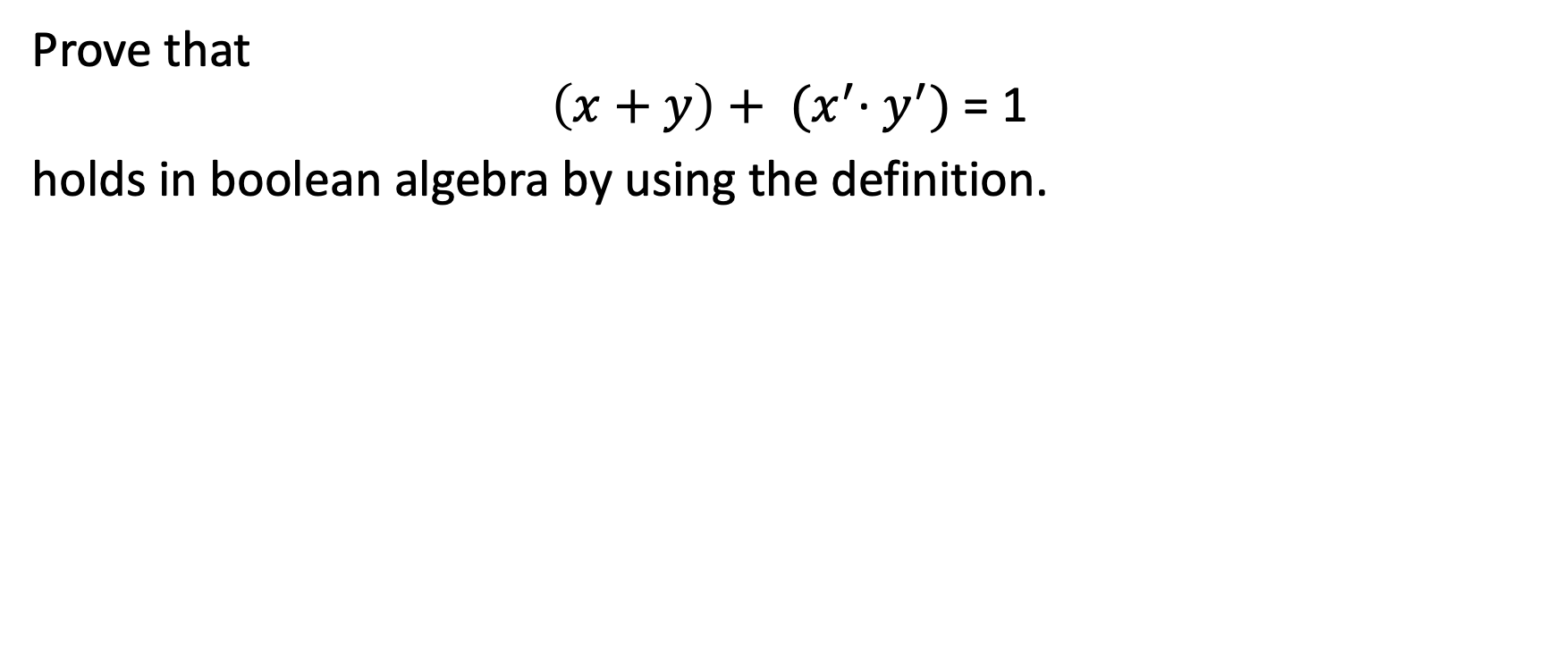
Example 8-1-3
Prove that
$$\left(x+y\right)+ {(x}^{′}\text{· }y^{′})\text{ = 1}$$
holds in boolean algebra by using the definition.

Slide 16
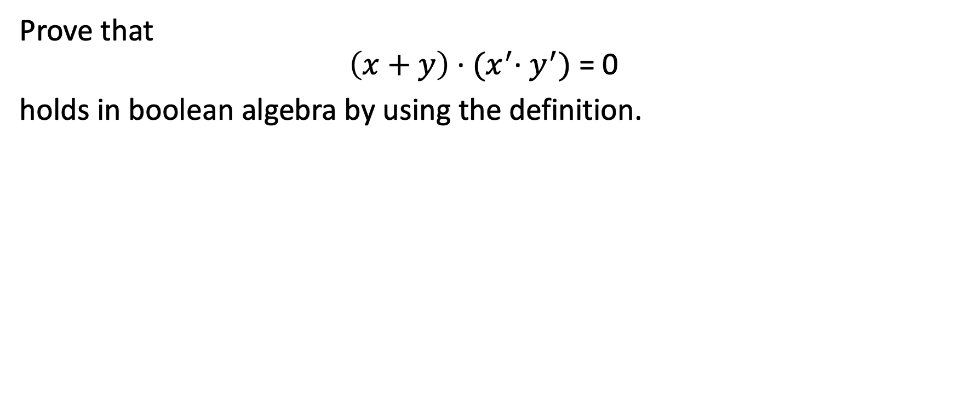
Example 8-1-4
Prove that
$$\left(x+y\right)\text{ ·} {(x}^{′}\text{· }y^{′})\text{ = 0}$$
holds in boolean algebra by using the definition.

Slide 17
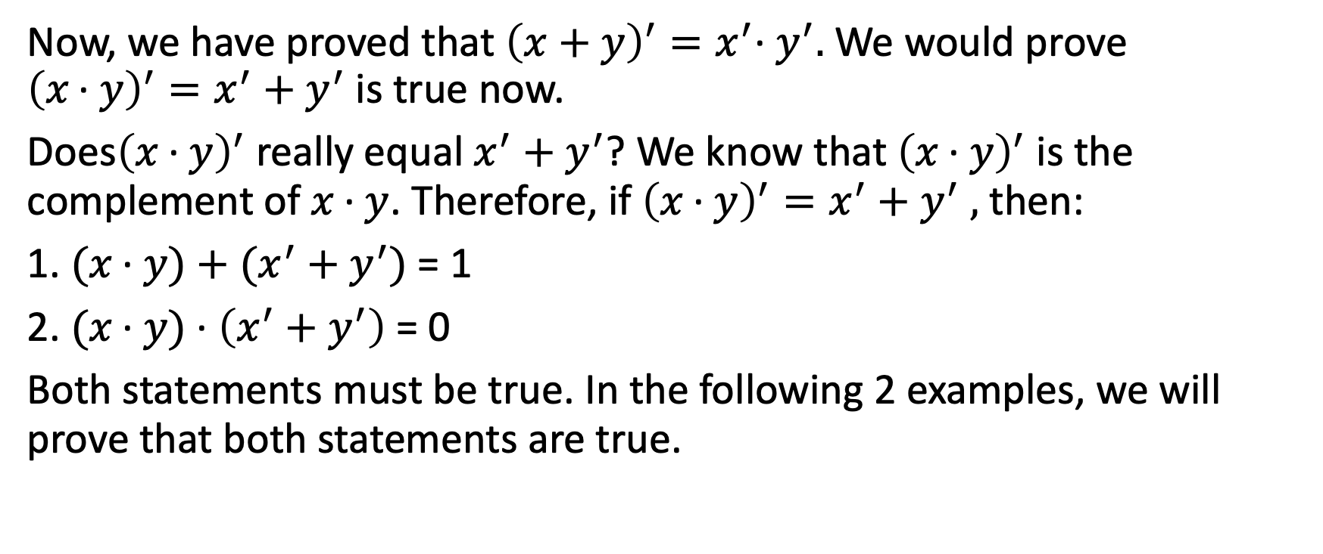
Proof II
Now, we have proved that ${\left(x+y\right)}^{′}=x^{′}\text{· }y^{′}.$We would prove ${\left(x \text{·} y\right)}^{′}=x^{′}+y^{′}$ is true now.
Does${\left(x \text{·} y\right)}^{′}$ really equal $x^{′}+y^{′}$? We know that${ \left(x \text{·} y\right)}^{′}$ is the complement of $x \text{·} y$. Therefore, if ${\left(x \text{·} y\right)}^{′}=x^{′}+y^{′}$ $,$ then:
1. $(x \text{·} y)+$ ${(x}^{′} +{ y}^{′})$= 1
2. $(x \text{·} y) \text{·}$ $\left(x^{′}+y^{′}\right)$= 0
Both statements must be true. In the following 2 examples, we will prove that both statements are true.

Slide 18
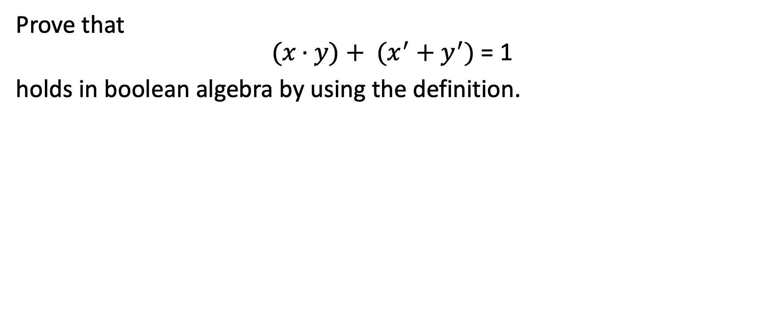
Example 8-1-5
Prove that
$$(x \text{·} y)+ {(x}^{′} +{ y}^{′}) \text{= 1}$$
holds in boolean algebra by using the definition.

Slide 19
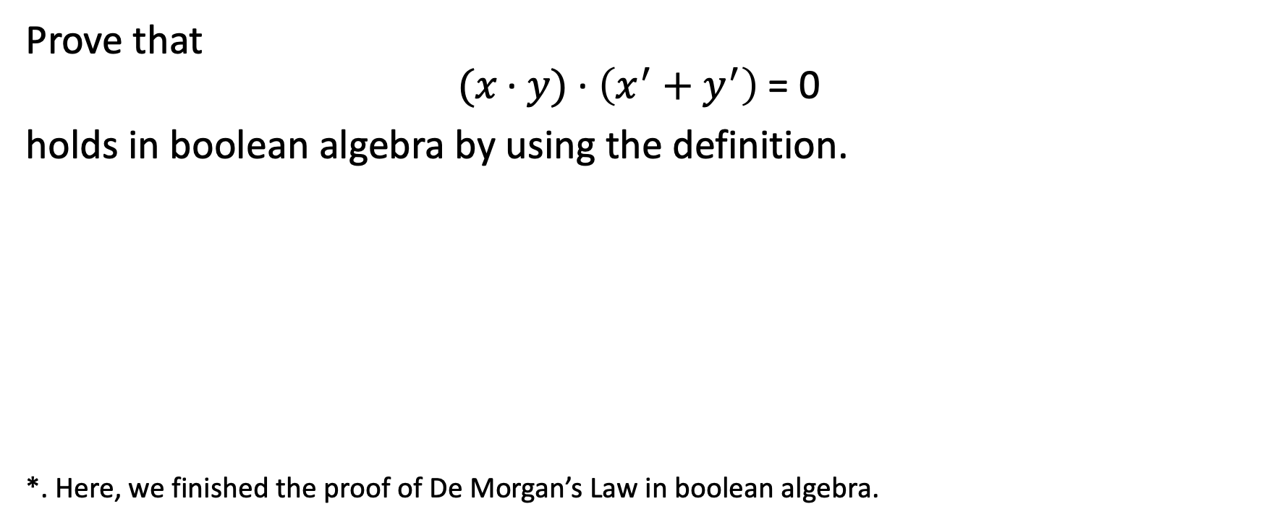
Example 8-1-6
Prove that
$$(x \text{·} y) \text{·} \left(x^{′}+y^{′}\right) \text{= 0}$$
holds in boolean algebra by using the definition.
*. Here, we finished the proof of De Morgan’s Law in boolean algebra.

Slide 20
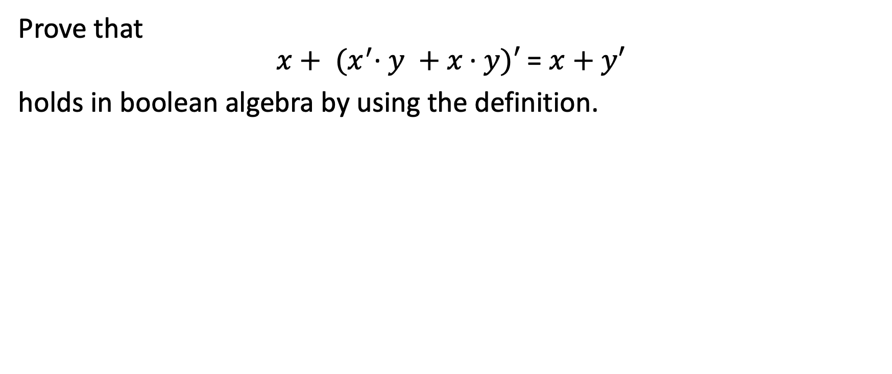
Example 8-1-7
Prove that
$$x+ {(x}^{′}\text{·} y +x \text{·} y)′ \text{= }x+y′$$
holds in boolean algebra by using the definition.

Slide 21

8-2 Logic Networks

Slide 22
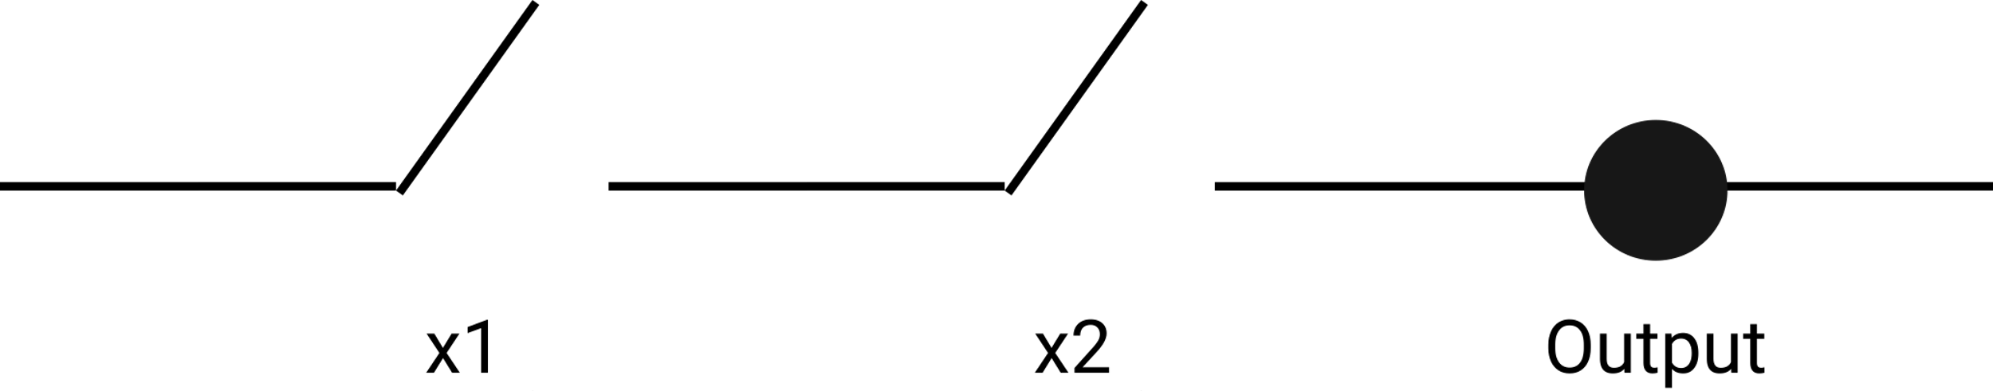
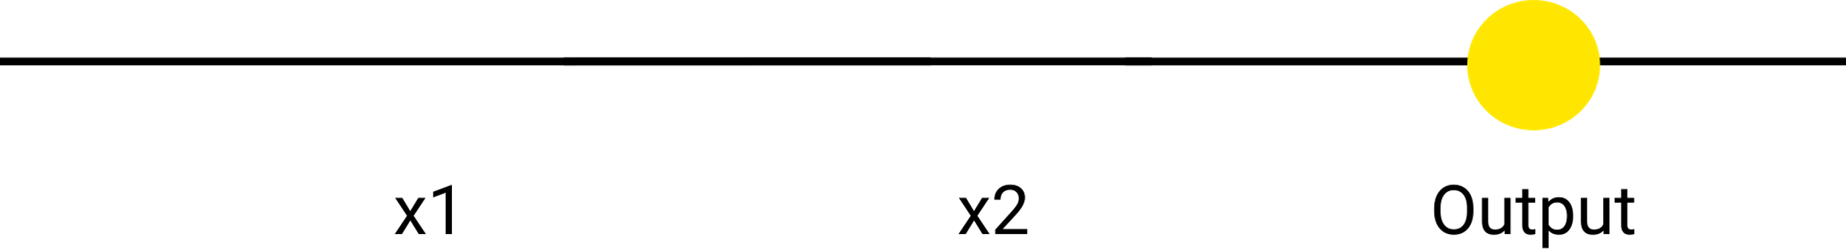
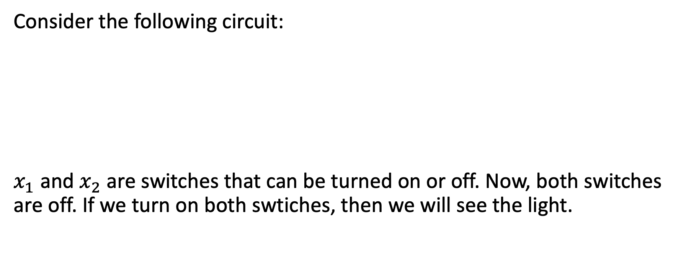
And Gate and Or Gate
Consider the following circuit:
$x_{1}$ and $x_{2}$ are switches that can be turned on or off. Now, both switches are off. If we turn on both swtiches, then we will see the light.

Slide 23
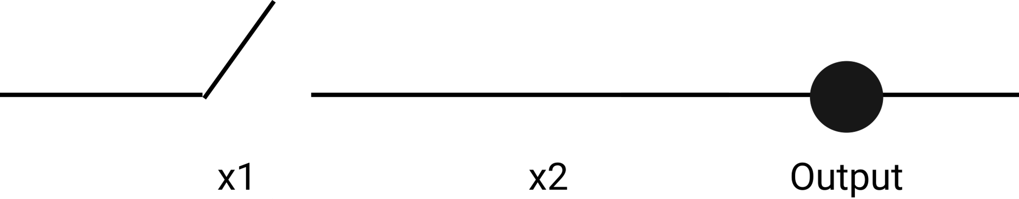
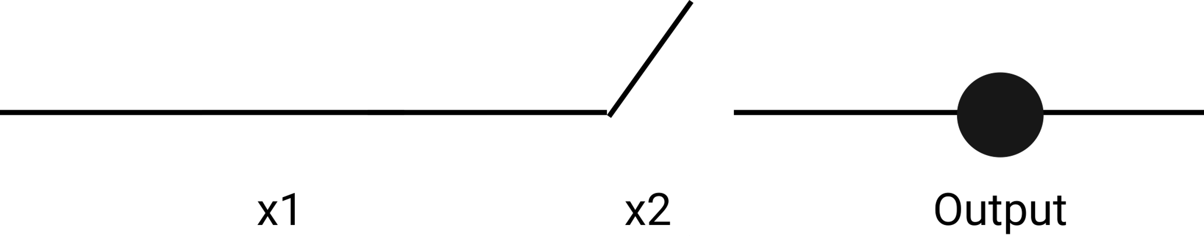
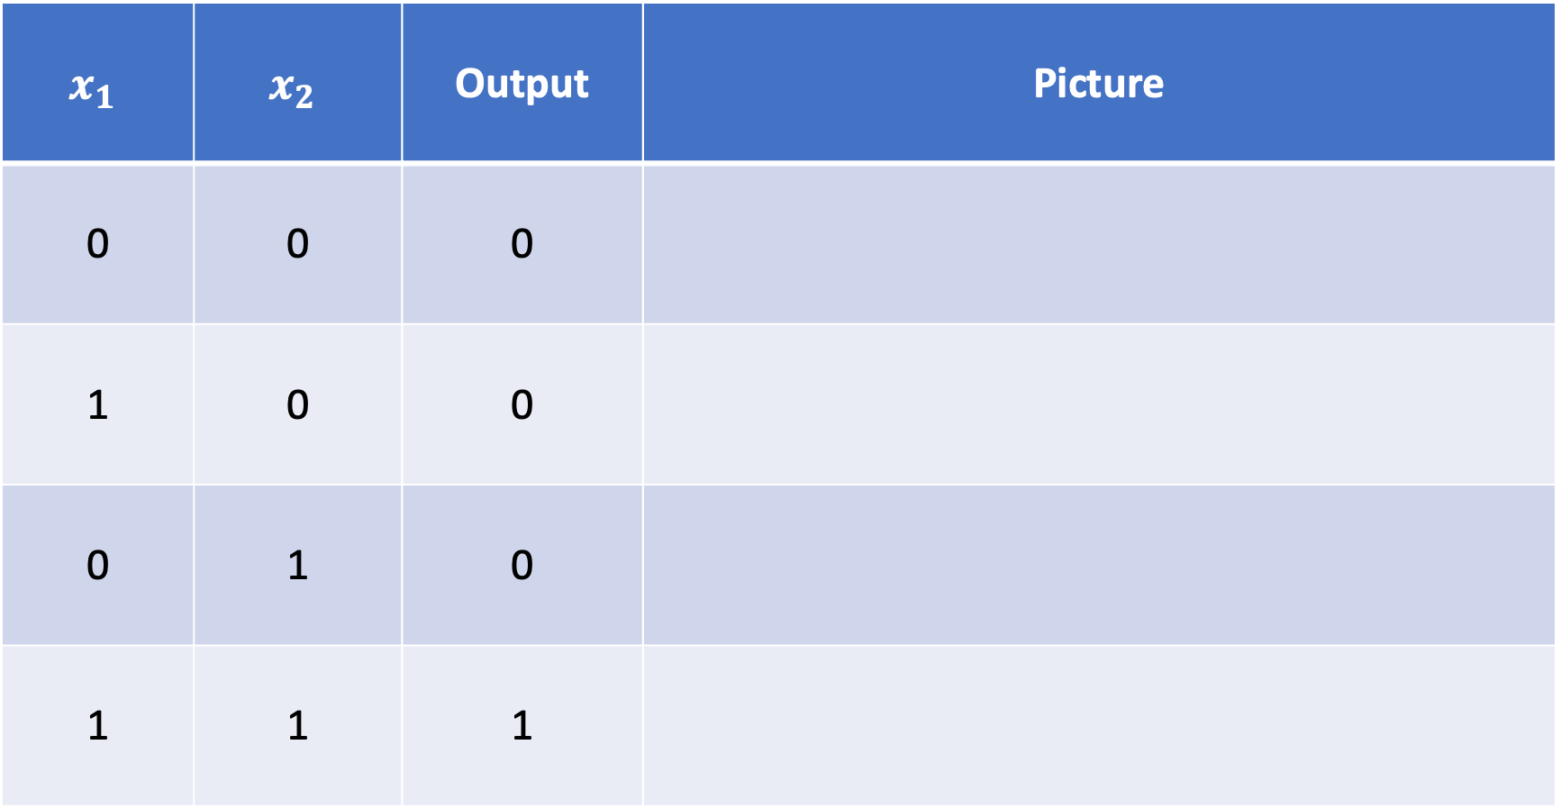
Now, for this circuit, we can write down the relations between switches and output.
$$x_{1}$$ | $$x_{2}$$ | Output | Picture
0 | 0 | 0
1 | 0 | 0
0 | 1 | 0
1 | 1 | 1

Slide 24
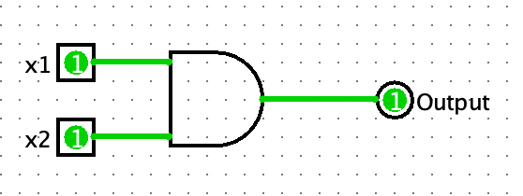
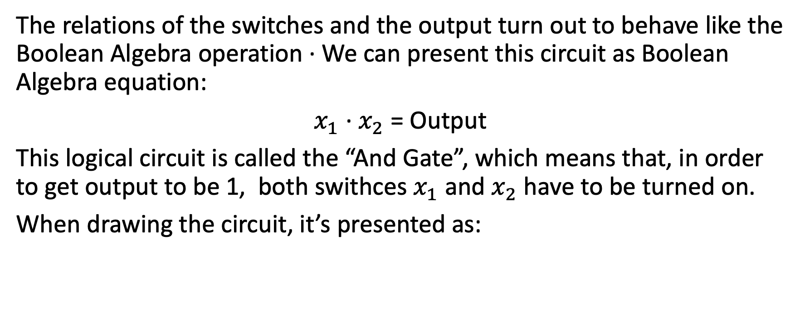
And Gate and Or Gate
The relations of the switches and the output turn out to behave like the Boolean Algebra operation $\text{·}$We can present this circuit as Boolean Algebra equation:
$x_{1}$ $\text{·}$ $x_{2}$ = Output
This logical circuit is called the “And Gate”, which means that, in order to get output to be 1, both swithces $x_{1}$ and $x_{2}$ have to be turned on.
When drawing the circuit, it’s presented as:

Slide 25
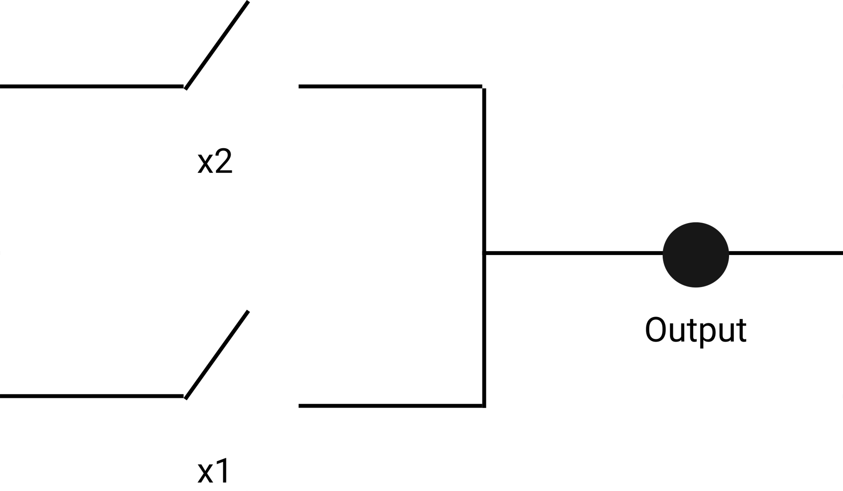
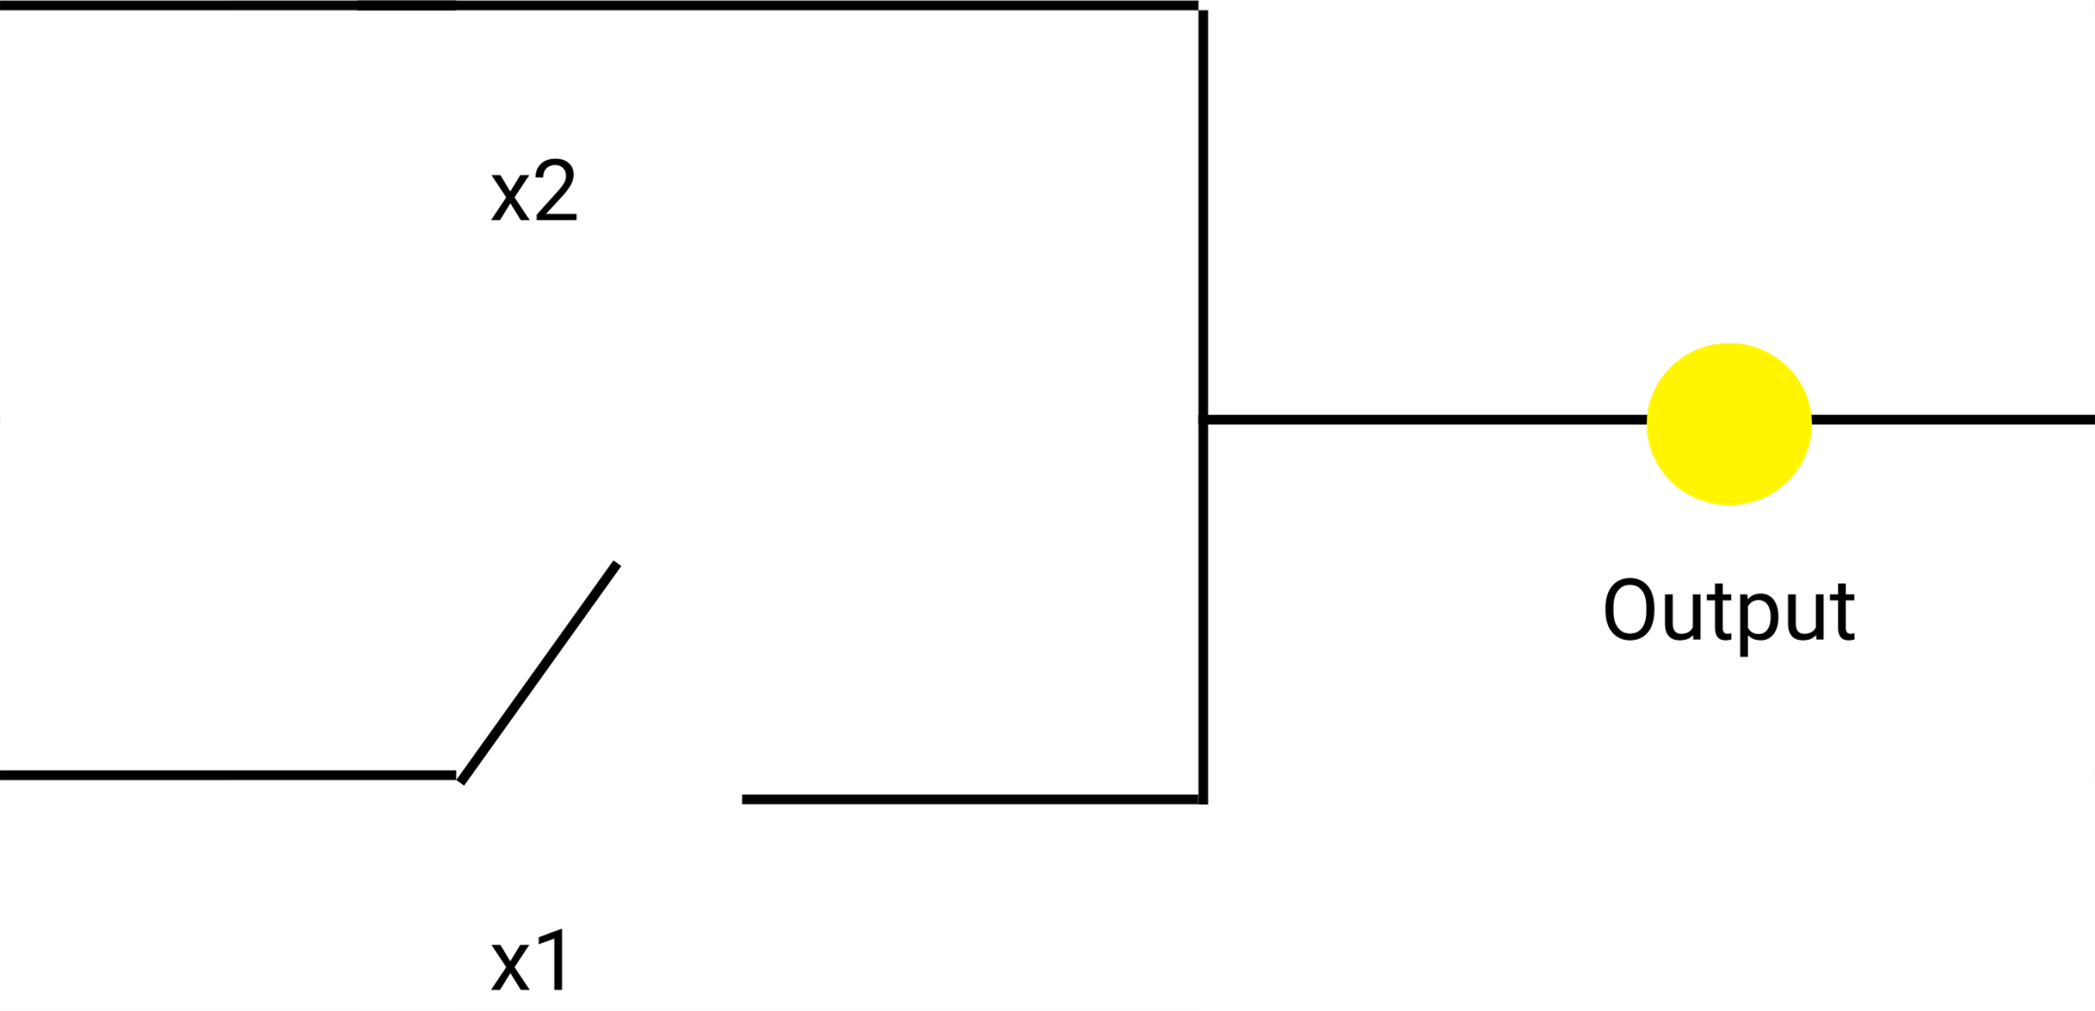
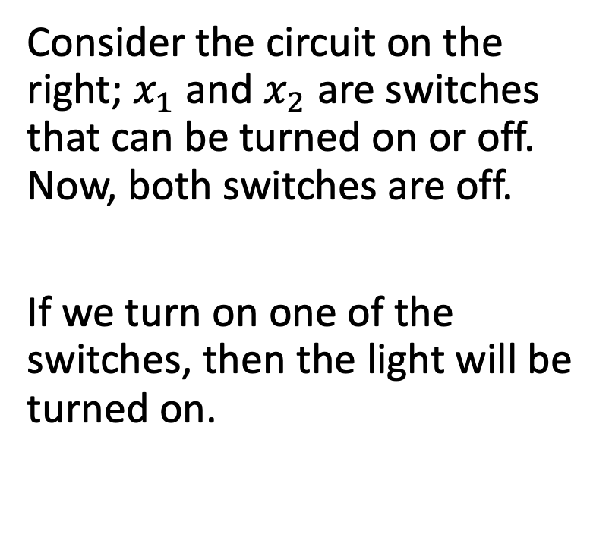
And Gate and Or Gate
Consider the circuit on the right; $x_{1}$ and $x_{2}$ are switches that can be turned on or off. Now, both switches are off.
If we turn on one of the switches, then the light will be turned on.

Slide 26
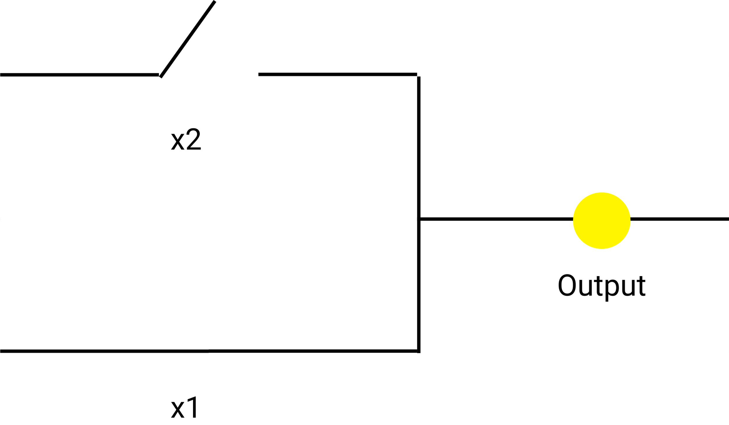

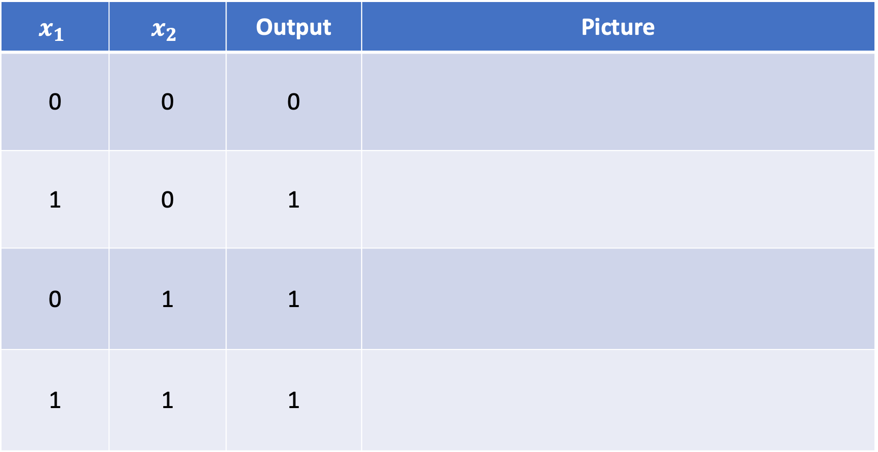
Now, for this circuit, we can write down the relations between switches and output.
$$x_{1}$$ | $$x_{2}$$ | Output | Picture
0 | 0 | 0
1 | 0 | 1
0 | 1 | 1
1 | 1 | 1

Slide 27
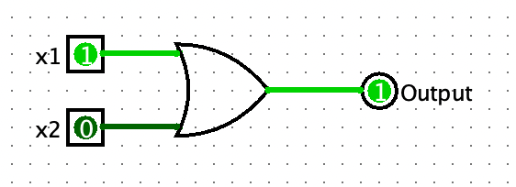
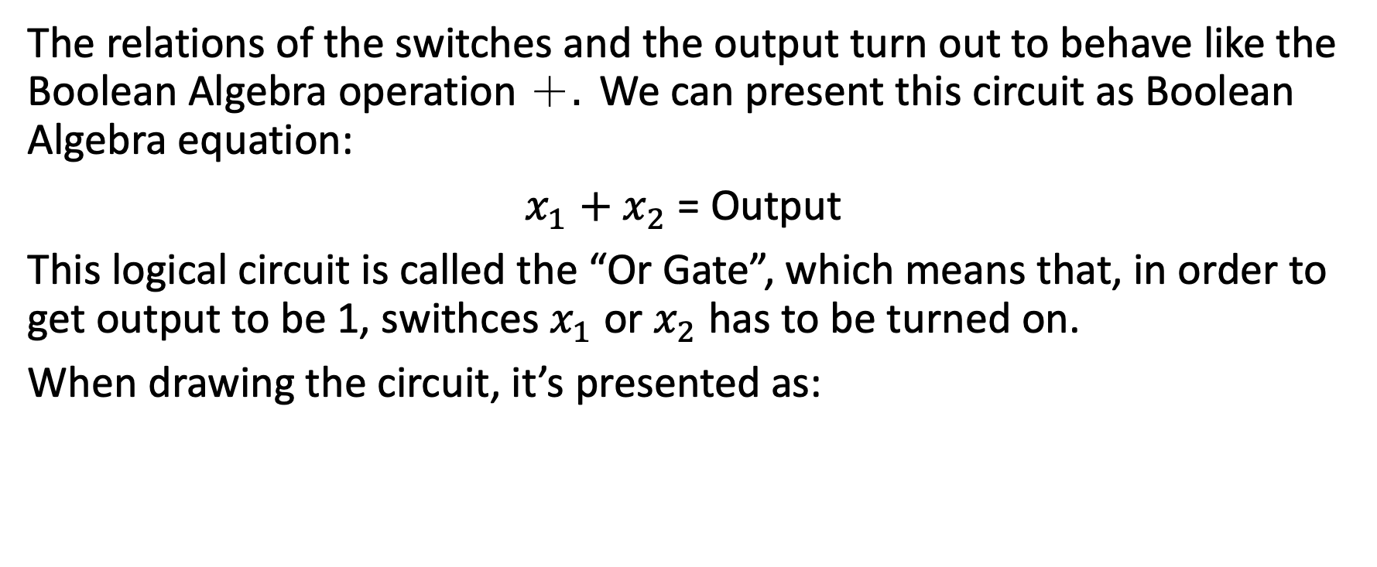
And Gate and Or Gate
The relations of the switches and the output turn out to behave like the Boolean Algebra operation ＋$.$We can present this circuit as Boolean Algebra equation:
$x_{1}$ $+$ $x_{2}$ = Output
This logical circuit is called the “Or Gate”, which means that, in order to get output to be 1, swithces $x_{1}$ or $x_{2}$ has to be turned on.
When drawing the circuit, it’s presented as:

Slide 28
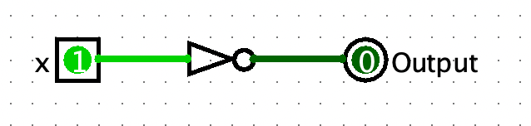
Not Gate
The ”Not Gate” is also know as the inverter. This circuit behaves like the Boolean algebra unary operation ‘.
When drawing the circuit, it’s presented as:
Now, we know that circuits can be represented as Boolean Algebra, and each Boolean Algebra equation (or Boolean expression) has a corresponding logical circuit. Let’s learn this concept from some examples:

Slide 29
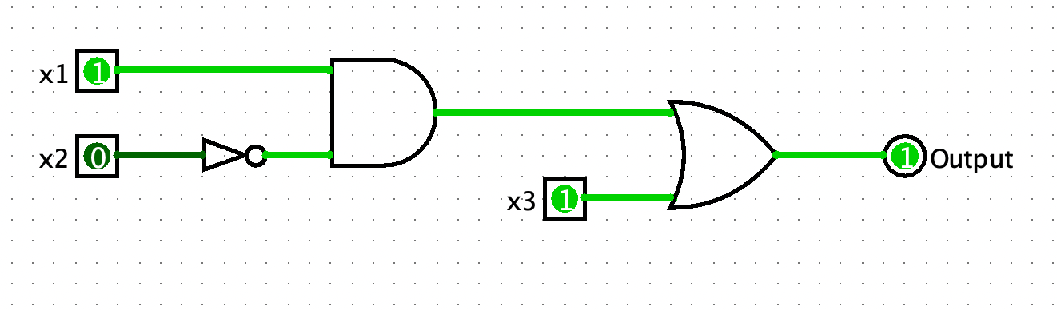
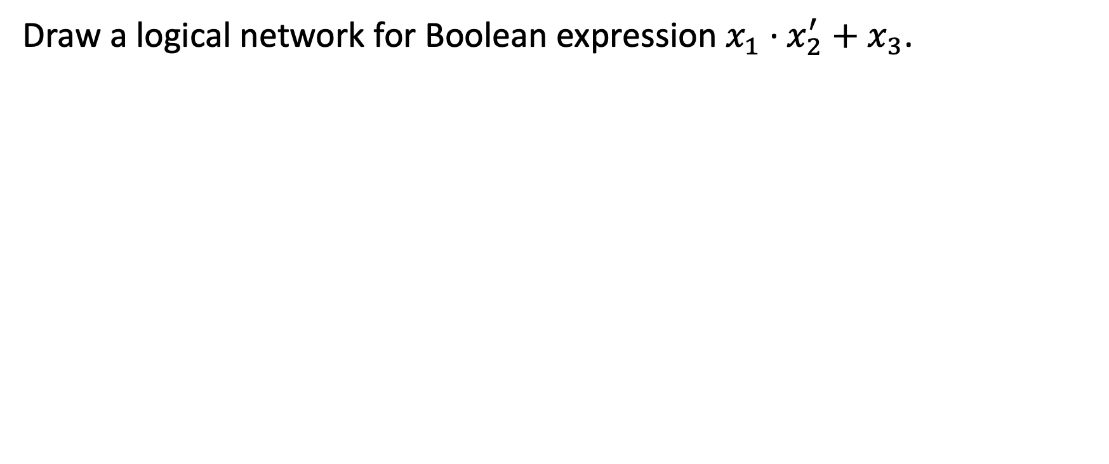
Example 8-2-1
Draw a logical network for Boolean expression $x_{1} \text{·} x_{2}^{′}+x_{3}$.

Slide 30
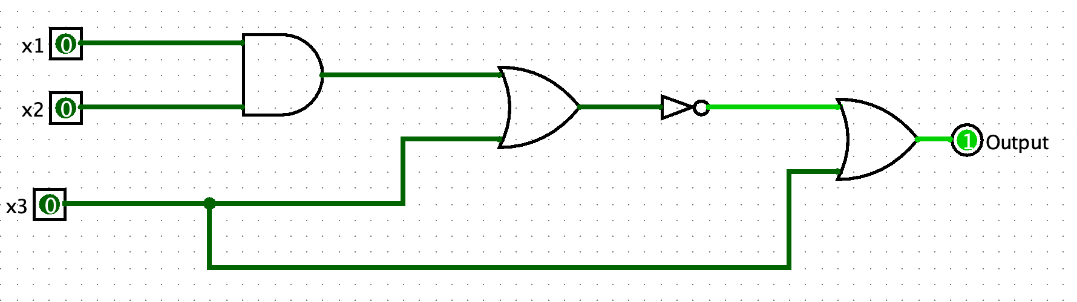
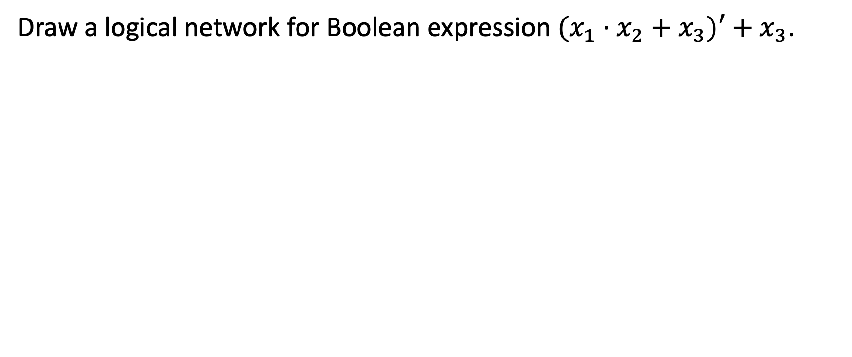
Example 8-2-2
Draw a logical network for Boolean expression ${(x}_{1} \text{·} x_{2}+x_{3})′+x_{3}$.

Slide 31
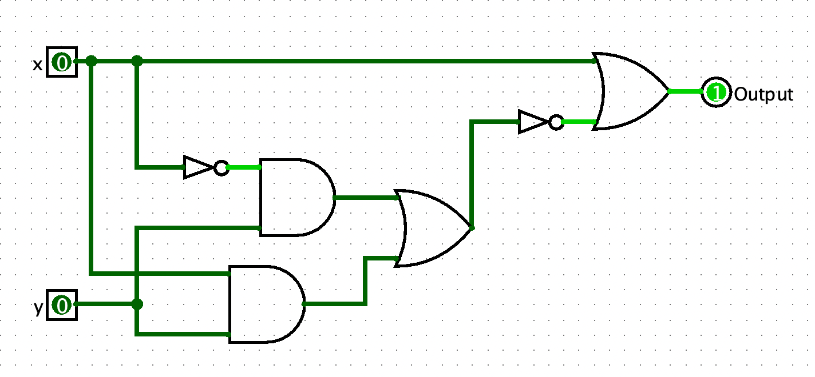
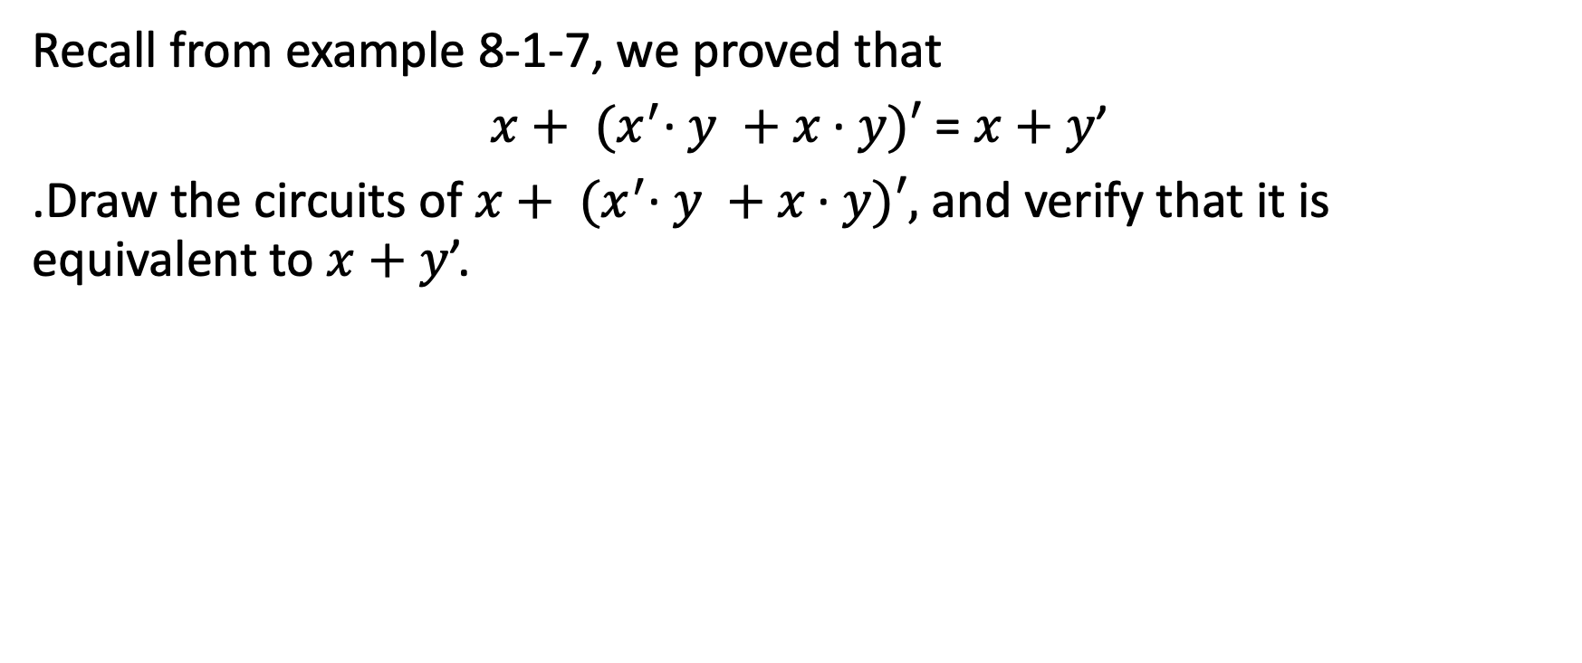
Example 8-2-3
Recall from example 8-1-7, we proved that
$x+ {(x}^{′}\text{·} y +x \text{·} y)′ \text{= }x+y$’
.Draw the circuits of $x+ {(x}^{′}\text{·} y +x \text{·} y)′,$ and verify that it is equivalent to $x+y$’.

Slide 32
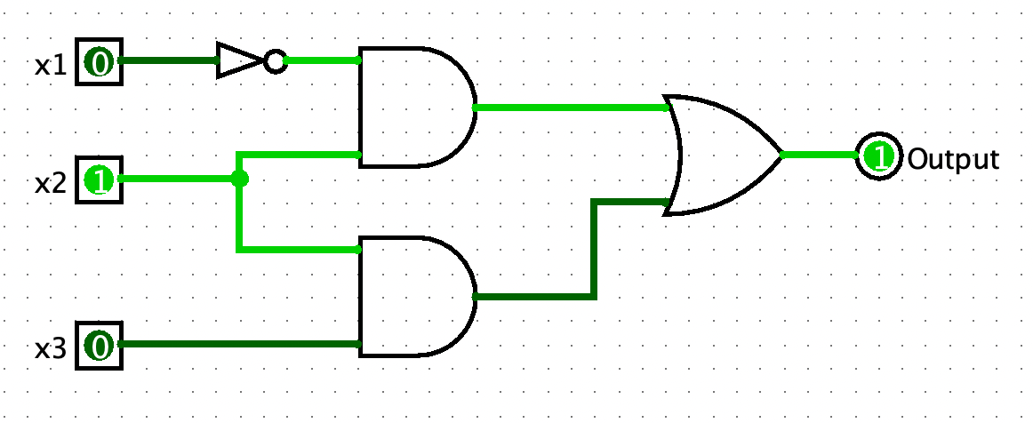
Example 8-2-4
Try to simplify the circuit below.

Slide 33
Build Boolean Expression
From chapter 1 and 8, all we have been doing is to contruct the truth table from a boolean expression. However, can we build a boolean expression from a truth table?
For example, what boolean expression is associated with the following truth table? (Think about it, do you have any good idea?)
x1 | x2 | Output
1 | 1 | 1
1 | 0 | 0
0 | 1 | 1
0 | 0 | 0

Slide 34
Build Boolean Expression
Building a boolean expression from a given truth table is a lot trickier than contructing a truth table from a given boolean expression.
Luckily, someone had already figure it out. The most 2 common approaches to find the boolean expression from a given truth table are:
Disjuctive Normal Form (DNF, or a.k.a. Sum of Products)
Conjuntive Normal Form (CNF, or a.k.a. Product of Sums)

Slide 35
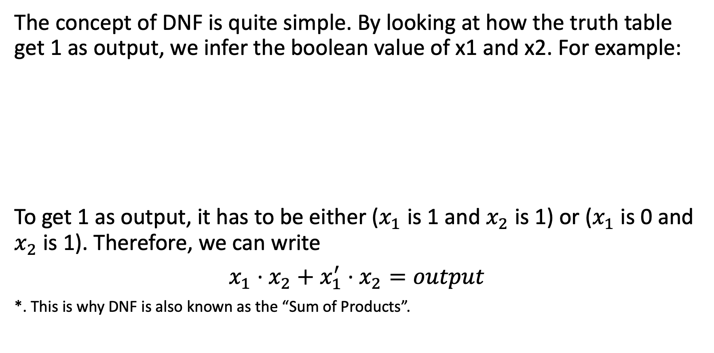
Disjunctive Normal Form
The concept of DNF is quite simple. By looking at how the truth table get 1 as output, we infer the boolean value of x1 and x2. For example:
To get 1 as output, it has to be either ($x_{1}$ is 1 and $x_{2}$ is 1) or ($x_{1}$ is 0 and $x_{2}$ is 1). Therefore, we can write
$x_{1}$ $\text{·}$ $x_{2}+x_{1}^{′} \text{·} x_{2}=output$
*. This is why DNF is also known as the “Sum of Products”.
x1 | x2 | Output
1 | 1 | 1
1 | 0 | 0
0 | 1 | 1
0 | 0 | 0

Slide 36
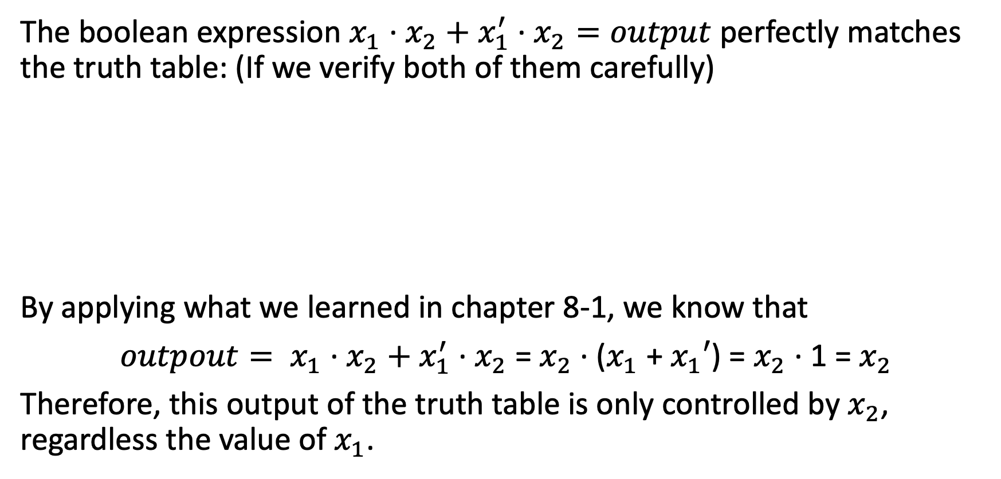
Disjunctive Normal Form
The boolean expression $x_{1}$ $\text{·}$ $x_{2}+x_{1}^{′} \text{· }x_{2}=output$ perfectly matches the truth table: (If we verify both of them carefully)
By applying what we learned in chapter 8-1, we know that
${outpout= x}_{1}$ $\text{·}$ $x_{2}+x_{1}^{′} \text{· }x_{2}$ = $x_{2}$ $\text{·}$ ($x_{1}$ + $x_{1}′$) = $x_{2}$ $\text{·}$ 1 = $x_{2}$
Therefore, this output of the truth table is only controlled by $x_{2}$, regardless the value of $x_{1}$.
x1 | x2 | Output
1 | 1 | 1
1 | 0 | 0
0 | 1 | 1
0 | 0 | 0

Slide 37
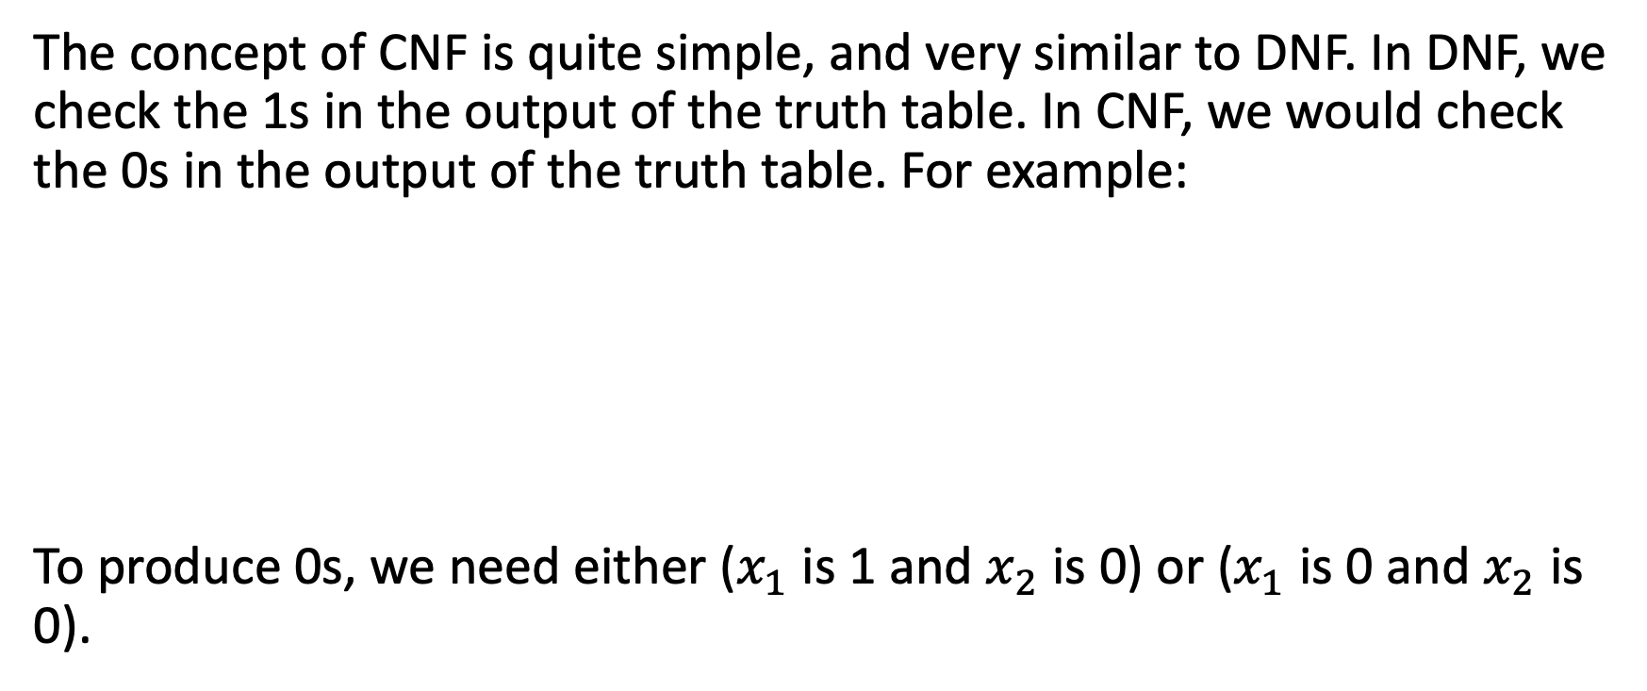
Conjuctive Normal Form
The concept of CNF is quite simple, and very similar to DNF. In DNF, we check the 1s in the output of the truth table. In CNF, we would check the 0s in the output of the truth table. For example:
To produce 0s, we need either ($x_{1}$ is 1 and $x_{2}$ is 0) or ($x_{1}$ is 0 and $x_{2}$ is 0).
x1 | x2 | Output
1 | 1 | 1
1 | 0 | 0
0 | 1 | 1
0 | 0 | 0

Slide 38
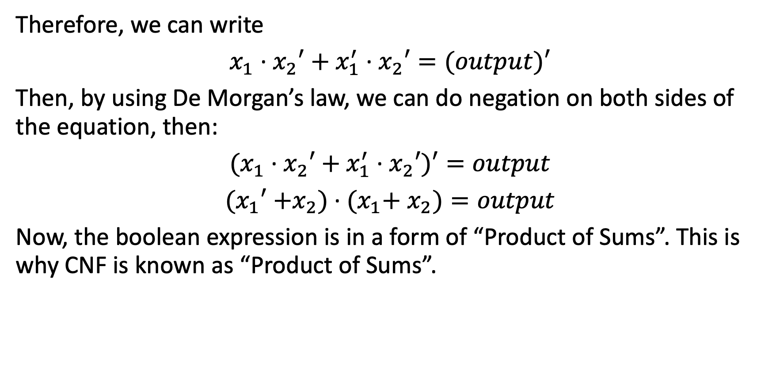
Conjuctive Normal Form
Therefore, we can write
$x_{1}$ $\text{·}$ $x_{2}′+x_{1}^{′} \text{· }x_{2}′=(output)′$
Then, by using De Morgan’s law, we can do negation on both sides of the equation, then:
$(x_{1}$ $\text{·}$ $x_{2}′+x_{1}^{′} \text{· }x_{2}′)′=output$
${(x}_{1}′$ $\text{+}x_{2}) \text{·} (x_{1}\text{+} x_{2})=output$
Now, the boolean expression is in a form of “Product of Sums”. This is why CNF is known as “Product of Sums”.

Slide 39
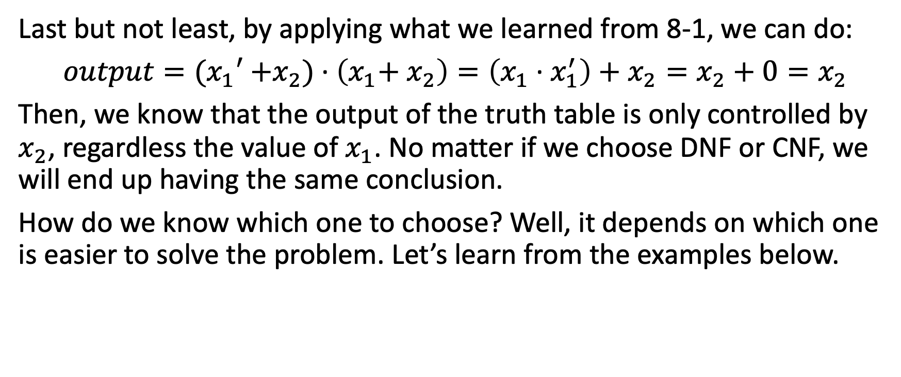
Conjuctive Normal Form
Last but not least, by applying what we learned from 8-1, we can do:
$output={(x}_{1}′$ $\text{+}x_{2}) \text{· }\left(x_{1}\text{+} x_{2}\right)=\left(x_{1} \text{·}{ x}_{1}^{′}\right)+$ $x_{2}=x_{2}+0=x_{2}$
Then, we know that the output of the truth table is only controlled by $x_{2}$, regardless the value of $x_{1}$. No matter if we choose DNF or CNF, we will end up having the same conclusion.
How do we know which one to choose? Well, it depends on which one is easier to solve the problem. Let’s learn from the examples below.

Slide 40
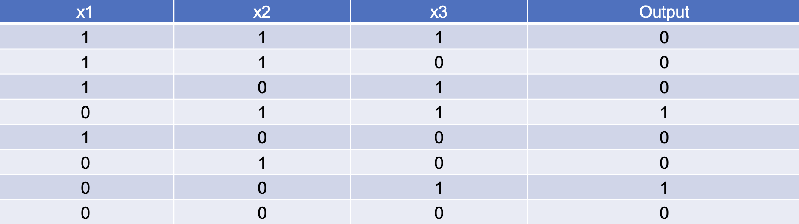
Example 8-2-5
Given the following truth table, find the boolean expression, and draw the logical circuit.

Slide 41
Addition in Binary and Decimal Systems
Let’s quickly learn about how to do addition in decimal and binary systems. We all learned how to do addition in decimal number system; what about binary? How do we add 10101 and 11111 together?
First, let’s recall that binary numbers can be converted into decimal numbers:
Decimal | Binary
0 | 00
1 | 01
2 | 10
3 | 11

Slide 42
Addition in Binary and Decimal Systems
Then, when we are doing addition in binary numbers, if we come across a number that is not a binary number, we change it from decimal to binary.
For example, we add 10101 and 11111 together, the result will be 110100.

Slide 43
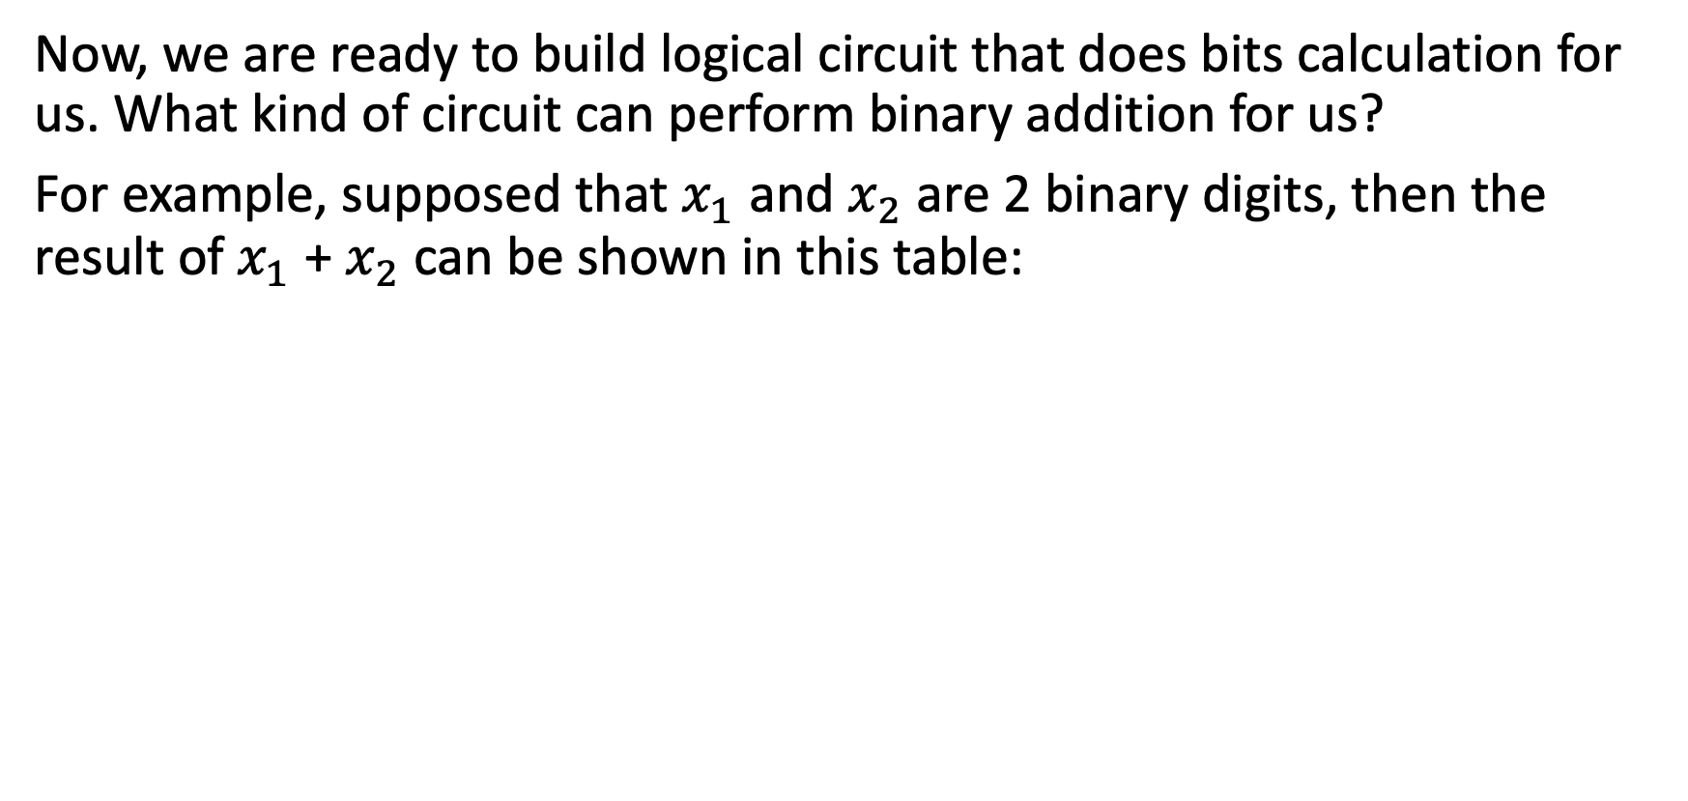
Logical Circuit of Bits Calculation
Now, we are ready to build logical circuit that does bits calculation for us. What kind of circuit can perform binary addition for us?
For example, supposed that $x_{1}$ and $x_{2}$ are 2 binary digits, then the result of $x_{1}$ + $x_{2}$ can be shown in this table:
x1 | x2 | Result of x1+x2
0 | 0 | 00
0 | 1 | 01
1 | 0 | 01
1 | 1 | 10

Slide 44
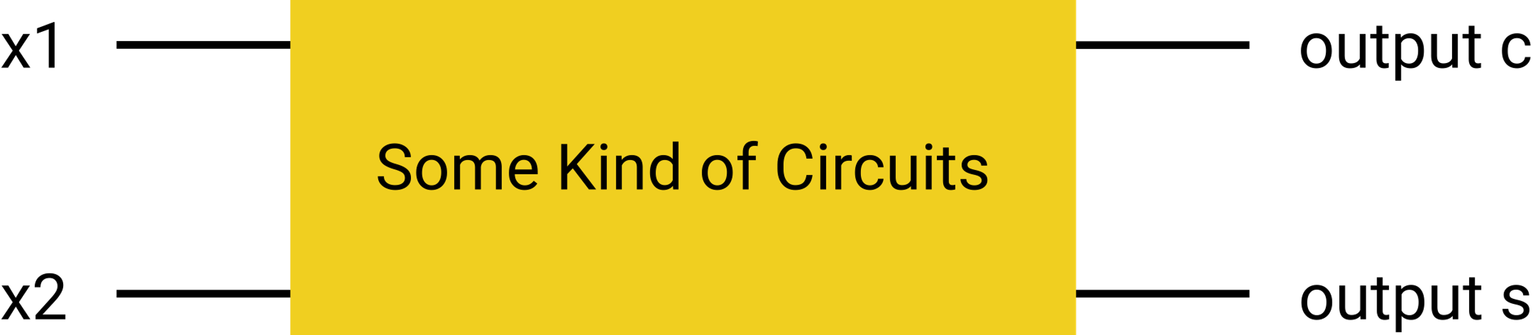
Logical Circuit of Bits Calculation
Supposed the first bit of the result is c, and the second bit of the result is s, then we aim to create a logical circuit such that it takes x1 and x2 as input, and produce the right c and s for us.
How do we design the circuit? Well, we can work on c and s separately. First, let’s work on c.

Slide 45
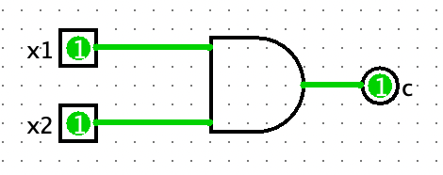
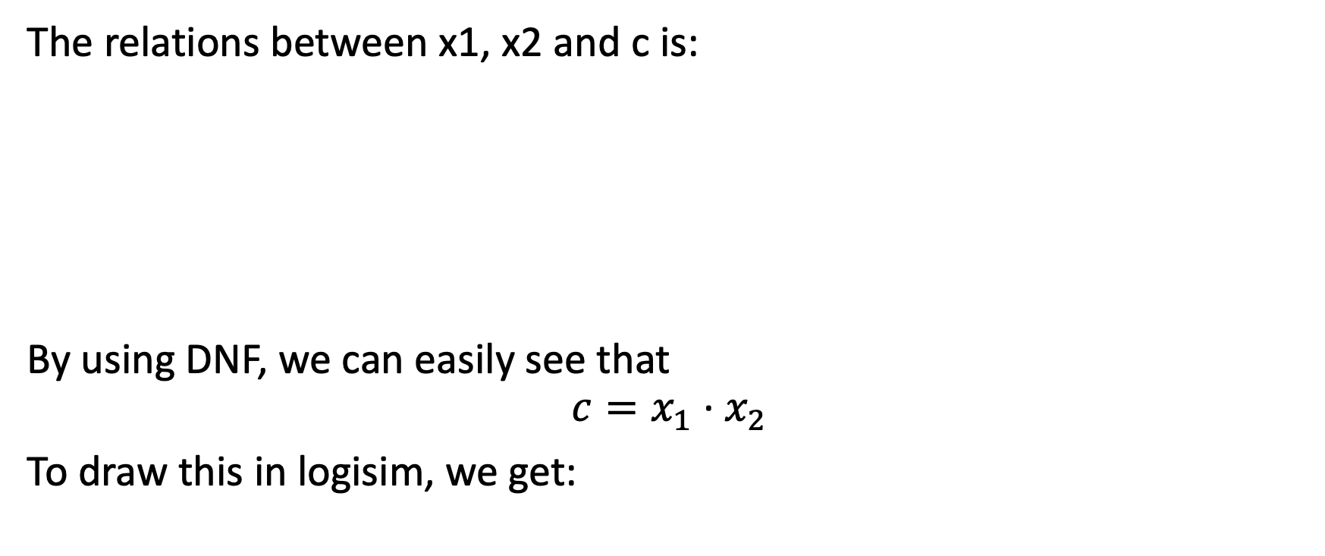
Logical Circuit of Bits Calculation
The relations between x1, x2 and c is:
By using DNF, we can easily see that
$$c=x_{1} \text{·} x_{2}$$
To draw this in logisim, we get:
x1 | x2 | c
1 | 1 | 1
0 | 1 | 0
1 | 0 | 0
0 | 0 | 0

Slide 46
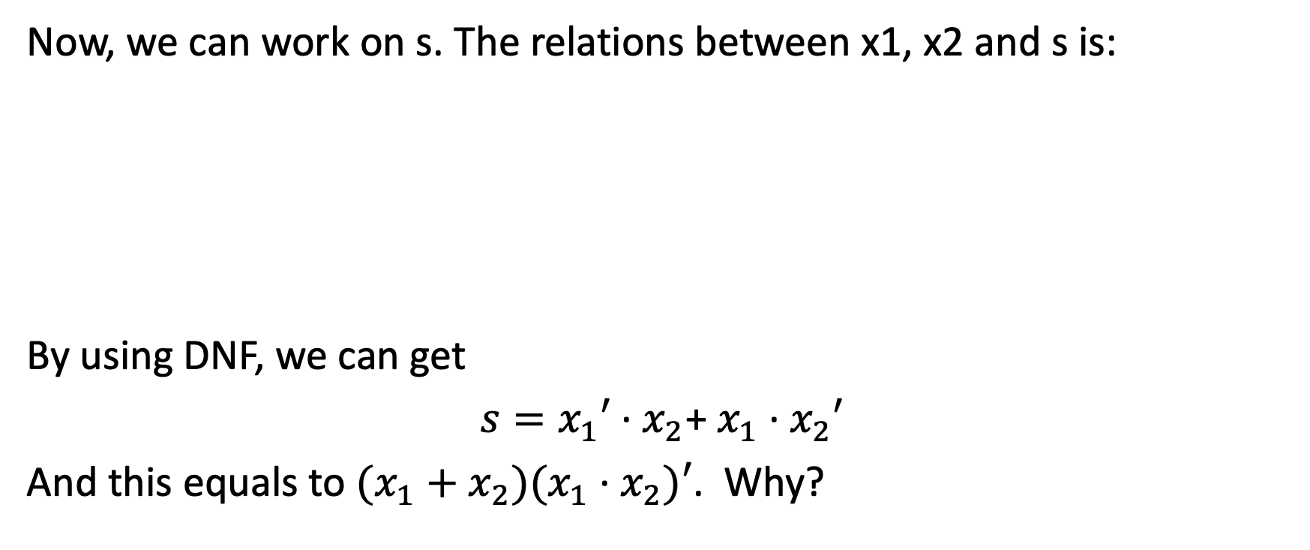
Logical Circuit of Bits Calculation
Now, we can work on s. The relations between x1, x2 and s is:
By using DNF, we can get
$s=x_{1}′{\text{·} x}_{2}$+ $x_{1} \text{·} x_{2}′$
And this equals to ${(x_{1}+x_{2})(x}_{1} \text{·} x_{2})′$. Why?
x1 | x2 | s
1 | 1 | 0
0 | 1 | 1
1 | 0 | 1
0 | 0 | 0

Slide 47
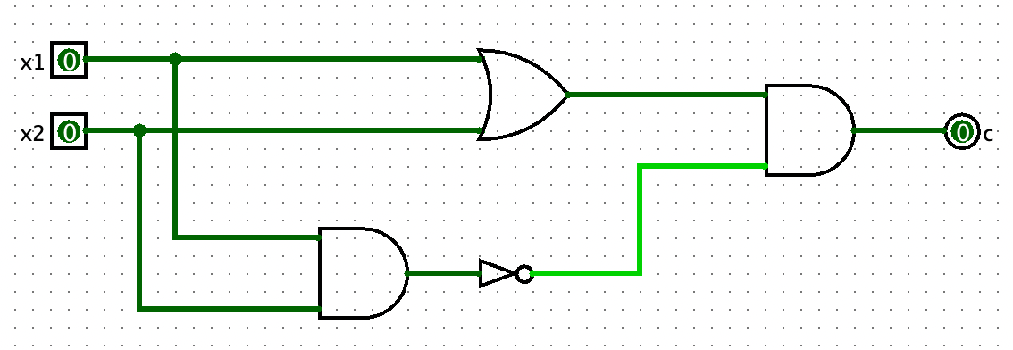

Logical Circuit of Bits Calculation
${(x_{1}+x_{2})(x}_{1} \text{·} x_{2})′=$ ${(x_{1}+x_{2})(x}_{1}′+ x_{2}′)=$ $x_{1}\text{·} x_{1}^{′}+$ $x_{1}′{\text{·} x}_{2}$+ $x_{1} \text{·} x_{2}^{′}+x_{2}$ $\text{·}$ $x_{2}′$ = 0 + $x_{1}′{\text{·} x}_{2}$+ $x_{1} \text{·} x_{2}′$ + 0 = $x_{1}′{\text{·} x}_{2}$+ $x_{1} \text{·} x_{2}′$
This is how we got
$s=x_{1}′{\text{·} x}_{2}$+ $x_{1} \text{·} x_{2}′$ = ${(x_{1}+x_{2})(x}_{1} \text{·} x_{2})′$
To draw this in logisim, we get:

Slide 48


Half-Adder
Now, we can combine the circuit, and we get:
This is called a half-adder. It handles the addition of 2 binary numbers, $x_{1}$ and $x_{2}$. The result is store in c and s.

Slide 49


Full-Adder
After knowing how to design a circuit that does binary addition, how do we design a circuit that computes 111 + 111 = 1110? Consider the process of computing 111 + 111 = 1110, we know that:
1. The digit in the first 111 can be considered as $x_{1}$.
2. The digit in the second 111 can be sonsidered as $x_{2}$.
3. After getting the c and s from $x_{1}+x_{2}$, we need to add s to the $c_{i−1}$ to compute the real s.

Slide 50


Full-Adder
Then, the circuit that computes the ith digit of the result of 111 + 111 will be:
We compute $x_{1}+x_{2}$ of the ith digit, and we add s with $c_{i−1}$ so that we can find $s_{i}$. Half Adder 2 and 3 combined are called ”Full-Adder.”

Slide 51

8-3 Minimization

Slide 52
Karnaugh Map
Karnaugh map is invented by an electrical engineer, Maurice Karnaugh, in Nokia Bell Labs in 1953. (If you never hear about the Bell Labs, you should google and read about it. Tons of inventions are from this lab, such as language C, C++, Unix system, transistor, and many others.)
K-Map is used to change a truth table to its boolean expression. We learned how to do this by using DNF or CNF in chapter 8-2. However, by using DNF or CNF, we still need to minimize the boolean expression manually. By using K-Map, the result is automatically in its minimization form.

Slide 53
Karnaugh Map
Why minimization? Well, we always want to minimize the number of gates that we use; for example, not gate, and gate, and or gate. It’s because they all take up spaces in our chips (or CPU), and they use transistors.
More gates means CPU is slower, since each gate makes the current run slower.
More gates means more electricity is needed.
More electricity means more heat our CPU generates.
Therefore, by minimizing the number of gates we use, we can make smaller, cheaper, faster, and less electricity needed, less heat-generated CPUs.

Slide 54
Rules of Drawing K-Map
There are 4 general rules of drawing a K-Map:
Circle all 1’s and no 0’s.
The circle is a group of 1, 2, 4, 8, 16, … of 1s.
All circles must be as big as possible.
Make as few circles as possible.
Circles can go beyond the bounds of the table.

Slide 55
Example 8-3-1
Draw K-map for the truth table below:
A | B | Output
0 | 0 | 0
0 | 1 | 1
1 | 0 | 0
1 | 1 | 1

Slide 56
Example 8-3-2
Draw K-map for the truth table below: (For both orientation)
A | B | C | Output
1 | 1 | 1 | 0
1 | 1 | 0 | 1
1 | 0 | 1 | 0
0 | 1 | 1 | 0
1 | 0 | 0 | 0
0 | 1 | 0 | 1
0 | 0 | 1 | 1
0 | 0 | 0 | 1

Slide 57
Example 8-3-3
Draw K-map for the truth table below: (For just one orientation)
A | B | C | Output
0 | 0 | 0 | 0
0 | 0 | 1 | 0
0 | 1 | 0 | 1
0 | 1 | 1 | 1
1 | 0 | 0 | 1
1 | 0 | 1 | 1
1 | 1 | 0 | 1
1 | 1 | 1 | 0

Slide 58


Example 8-3-4
Change the following Kmap to its boolean expression:

Slide 59



Example 8-3-5
Change the following Kmap to its boolean expression:

